Slide 1

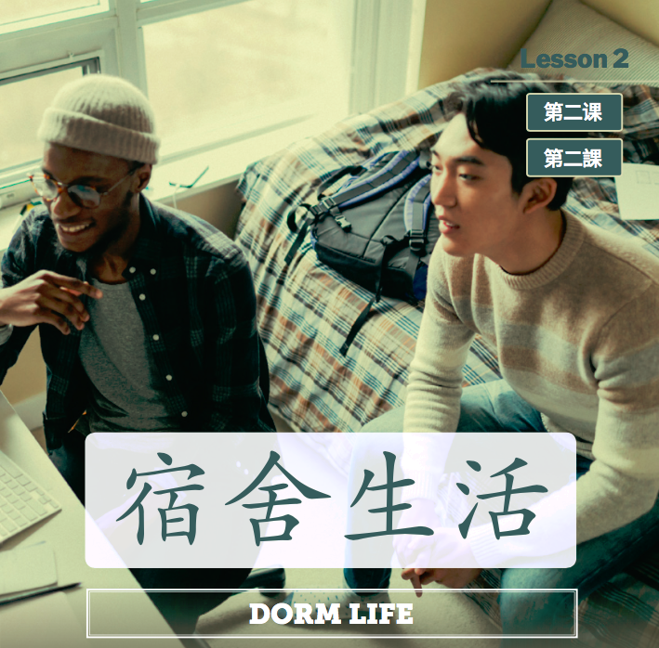
Dì kè: sùshè shēnghuá
第二课：宿舍生活 (Dorm Life)

Slide 2
第二课 学习目标 (Lesson 1 Learning objectives)
    In this lesson, you will learn to use Chinese to
Name basic pieces of furniture
Describe your living quarters
Comment on someone’s living quarters
Disagree tactfully

Slide 3
第二课 语法重点 (Forms & Accuracy)
Forms & Accuracy:
Existential Sentences
Adverb 真
比较
得很
那么
Conjunctions

Slide 4
第二课：宿舍生活
Shēng cí
生词
vocabulary

Slide 5
同屋
马路
空
旧
摆
挂
洗
恐怕
一般
真的
地道
着急
过几天
tóngwū
mǎlù
kōng
jiù
bǎi
guà
xǐ
kǒngpà
yìbān
zhēn de
dìdào
Zháojí
guòjǐtiān
roommate
road
empty
Old (of things)
to put; to place
to hang; to hang up
to wash
I am afraid that
general
Really; truly
authentic, genuine
to worry
In a few days

Slide 6
量词 liàngcí (Measure word)
栋
层
套
把
张
台
台
一 ____宿舍
二 ____楼
三 ____沙发
四 ____椅子
五 ____纸
六 ____洗衣机
七 ____烘干机
栋
层
台
张
把
套
dòng
céng
tái
zhāng
bǎ
tào

Slide 7
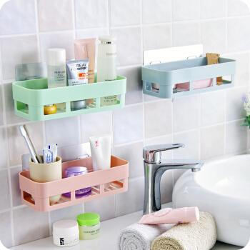
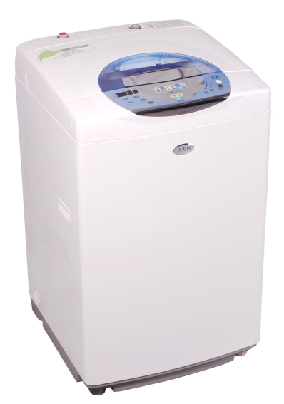
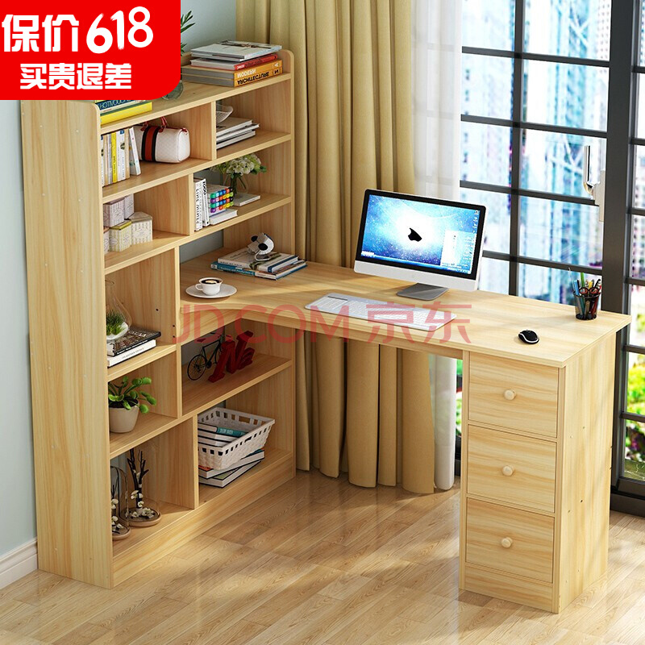
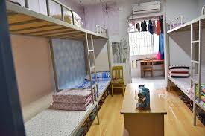
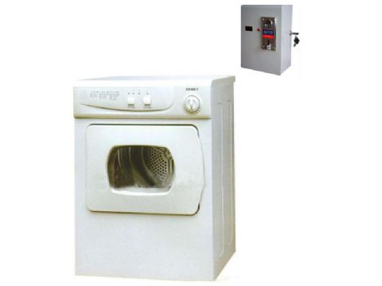
宿舍用品 sùshè yòng pǐn

Slide 8
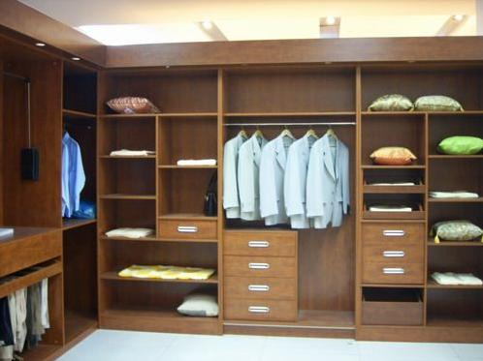
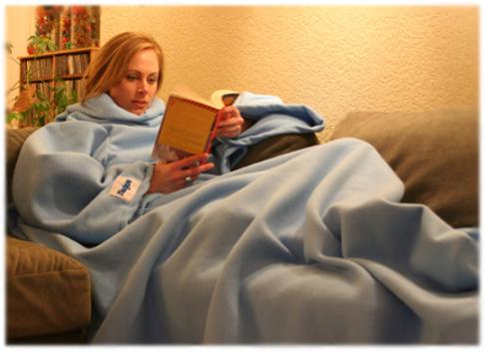
宿舍用品 sùshè yòng pǐn
被子
毯子
柜子
衣柜
空调
Bèizi
tǎnzi
guìzi
yīguì
kōngtiáo

Slide 9
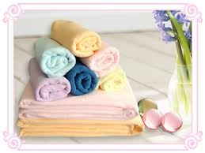
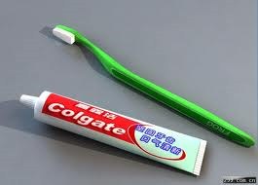
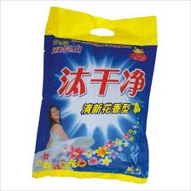

日用品 rì yòng pǐn (Daily necessities) noun
毛巾 máojīn
牙刷 yáshuā
牙膏 yágāo
洗衣粉 xǐyī fěn
卫生纸 wèishēngzhǐ

Slide 10
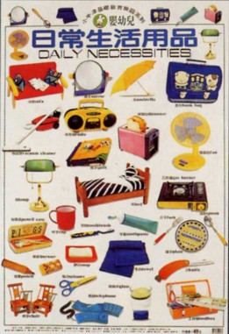
日用品 rì yòng pǐn (Daily necessities) noun

Slide 11
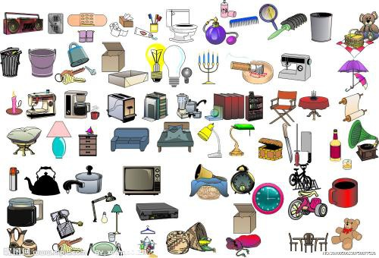

Slide 12
第二课：宿舍生活
Yǔ fǎ
语法
grammar

Slide 13
比较 bǐjiào (relatively, comparatively, rather) adverb/v
It is used to express relative degree or extent.
这个空调比较贵，你别买了。
This air conditioner is rather expensive. Don’t buy it.
今天比较冷，你多穿点衣服吧。
It’s pretty cold today. You’d better put on more clothes.
Q:你喜欢什么运动？
A:我比较喜欢打网球。
(Generally speaking, ) I prefer playing tennis.

Slide 14
比 to compare 比较 relatively, comparatively, rather
Q: HP电脑和苹果电脑比，哪个比较贵？
A: HP电脑和苹果电脑比，苹果电脑比较贵。
苹果电脑和HP电脑比，苹果电脑比较贵。
苹果电脑比HP电脑贵一点儿/得多。
苹果电脑比HP电脑更贵。
A和B比，A比较adj.
A比B+adj+一点儿/得多
A比B+更+adj

Slide 15
比 to compare 比较 relatively, comparatively, rather
我哥哥比我高。→ 我哥哥比较高。
我和我哥哥比，我哥哥比较高。
我很高，我哥哥更高。→我哥哥比我更高。

Slide 16

比 to compare 比较 relatively, comparatively, rather
今天天气冷…
今天天气挺冷的。
今天天气比较冷。
今天天气很冷。
今天天气冷得很。
今天天气真冷。
今天天气太冷了。
今天天气冷极了。
今天天气冷死了。

Slide 17
Existential Sentences
桌子上有一本书，一支笔和一份报纸。
桌子上有一本书。
桌子上是一本书。
bǎizhe
桌子上摆着一本书。
There is a book (be put, but not be hung or stuck) on the desk.
桌子上是一本书，不是一份报纸。

Slide 18
真 zhēn (Really) Adverb
It is used to convey an affirmative , exclamatory tone of voice. It is used before adjectives and before verbs that denote thoughts or feelings.
这条裤子很好看，我想给哥哥也买一件。
这条裤子真好看，我想给哥哥也买一件。
这台烘干机很吵，你应该买一台新的。
这台烘干机真吵，你应该买一台新的。
The dryer is really noisy. You should get a new one.

Slide 19
真 zhēn (Really) Adverb
It is used to convey an affirmative , exclamatory tone of voice. It is used before adjectives and before verbs that denote thoughts or feelings.
今天真冷，穿三件毛衣都不行。
It’s really cold today. You could be wearing three sweaters, and you would still be cold.
老师给的功课真多，我做了三个钟头了还没做完。
My teacher really assigned a lot of homework. I’ve been at it for three hours, and I still haven’t finished it.

Slide 20
真的 zhēnde (really; truely) Adverb
Sometimes 真 means truly, honestly, and is followed by the particle 的
中文真的非常难学。
Chinese is really very hard to learn!
你真的喜欢她吗？
Do you truly like her?

Slide 21
真的 zhēnde (really; truely) Adverb
Sometime 真 means truly, honestly, and is followed by the particle 的
这碗酸辣汤真的又酸又辣。
This bowl of Hot and Sour Soup is truly hot and sour.
学校的宿舍真的太贵了，我真的想搬到校外去住。
It is really too expensive to live in the dorm. I honestly want to move off campus.

Slide 22
得很 (Denote thoughts or feelings to suggest an extreme extent )
  冷得很
  多得很
  高兴得很
学校刚刚开学，大家都忙得很。
School just started. Everyone has been extremely busy.
我没吃早饭，所以现在…。
昨天我睡得特别晚，所以今天…
饿得很。
累得很。

Slide 23
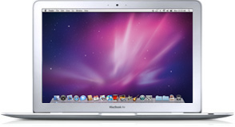
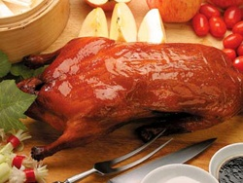
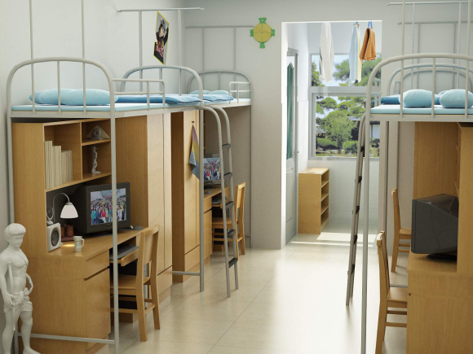
得很 (Denote thoughts or feelings to suggest an extreme extent )
学校刚开学，大家都忙得很。
我三年没回家了，想家得很。
他今天考试考了100分，___。
这台笔记本电脑儿贵吗？
那家餐馆的北京烤鸭好吃吗？
你的那栋宿舍安静吗？
高兴得很。
贵得很。
好吃得很。
安静得很。

Slide 24
那么 (then) conjunction
To suggest
1. A:晚上去买洗衣机，好吗？
B:可是今晚我没空儿。
A:那(么)就明天吧。
B:好吧。
2. A:周末我们去海边吧。 B:没兴趣。
A:那么去爬山？ B:也没兴趣。
A:那么就在家看电视吧。B:好。

Slide 25
那么 (then) conjunction
To suggest
1. A:晚上去买洗衣机，好吗？
B:可是今晚我没空儿。
A:那(么)就明天吧。
B:好吧。
2. A:周末我们去海边吧。 B:没兴趣。
A:那么去爬山？ B:也没兴趣。
A:那么就在家看电视吧。B:好。

Slide 26
连词 liáncí (Conjunctions)
A:真热！你的宿舍怎么没有空调？
B:因为_________________。（this building is rather old.）
A:这儿吵不吵？
B:不吵，因为___________。(it’s far away from the road.)
A:你上个学期刚搬到校外，这个学期怎么又搬进校内了？
B:因为_________________。

Slide 27
第二课：宿舍生活
单词&片语
Dāncí piànyǔ
(Words & Phrases)

Slide 28
恐怕 kǒngpà (I’m afraid that…; I think perhaps) adverb
It is used to express the speaker’s assessment of or concern about a particular situation.
下雨了，恐怕我们不能打球了。
It is raining. I’m afraid we can’t play ball.
已经十二点了，现在给他打电话恐怕太晚了。
It’s 12 am already. I’m afraid it’s too late to call him now.

Slide 29
恐怕 kǒngpà (I’m afraid that…; I think perhaps) adverb
It is used to express the speaker’s assessment of or concern about a particular situation.
窗户外有一条马路，这儿恐怕很吵吧。
There’s a street outside the window. It must be very noisy here, right?
*馬路/马路 mǎlù road

Slide 30
恐怕 kǒngpà (I’m afraid that…; I think perhaps) adverb
Can you use 恐怕 to complete the following sentences,
这儿没有空调，_____________________。
这个宿舍离马路很近，_______________。
我觉得很不舒服，___________________。
Q: 我想搬到Alaska去。
A: 是吗？__________。

Slide 31
吵 chǎo (noisy) adjective
外边很吵，我不能看书。
It’s very noisy out there. I can’t read.
我的宿舍很安静，一点儿也不吵。
My dorm is very quiet, and not noisy at all.

Slide 32
吵 chǎo (to quarrel ) verb
昨天，他和他的同屋吵起来了。
He quarreled with his roommate yesterday.
*同屋 tóngwū =室友 shìyǒu (roommate)
你们两个别吵了！有什么问题，好好说。
Stop quarreling, you two. It there’s a problem, talk it out.

Slide 33
安静 ānjìng (quiet) adjective
上课以后，教室里很安静。
When class begins, the classroom is very quiet.
请保持安静。
Please be quiet.
我们找一个安静的地方聊聊， 好吗？
Let’s find a quiet place to talk, OK?

Slide 34
安静 ānjìng (quiet) adjective
我喜欢住在校外，因为宿舍太吵了,
I like to live off campus because dorms are noisy.
住在校外比较安静。
living off campus is quieter.

Slide 35
差不多 chàbùduō (about, roughly) adverb
我跟姐姐差不多高。
I’m about the same height as my older sister.
从我家到学校，走路差不多十分钟。
It’s about a ten-minute walk from my home to school.
我每天差不多晚上十一点睡觉。
I go to sleep at about 11 pm everyday.

Slide 36
差不多 chàbùduō (almost the same ) adjective
他的弟弟跟他长得差不多。
His younger brother looks like him.
今天的天气跟昨天差不多，不冷不热，很舒服。
Today’s weather is very similar to yesterday’s—not too cold, not too hot, very comfortable.

Slide 37
一般 yìbān (generally) adverb
我一般在早上七点起床。
I generally get up at 7 am.
我听说学校餐厅的饭一般都不太好。
I hear that the school cafeteria is generally not very good.
星期一到星期五，她一般都在学校餐厅吃饭，
From Monday to Friday, she generally eats at the school cafeteria.
周末常常出去吃。
On weekends she often goes out to eat.

Slide 38
一般 yìbān (generally) adverb
这个学校很一般，不太有名。
This school is ordinary. It’s not very well known.
新生一般都没有车，差不多都找旧生带他们去买日用品。
Freshmen generally don’t have a car, and most likely need to ask old students to take them to buy daily necessities.

Slide 39
不怎么样 (Not that great; just so-so )
Q: 你觉得这个饭馆的菜怎么样？
A: 那个饭馆的菜不怎么样，我觉得不好吃。
The food of that restaurant is just so-so. I don’t think it’s delicious.
Q:你觉得这栋楼怎么样？
A:我觉得不怎么样，太旧了。
*栋 dòng (A measure word for a building)
旧 jiù (old)

Slide 40
不怎么样 (Not that great; just so-so )
It is a colloquial expression, usually used as a predicate meaning “not that great.”
Q: 这个图书馆怎么样？
A: 不怎么样，书很少。
This library is not that great. There are very few books.
Q: 你觉得他唱歌唱得怎么样？
What do you think about his singing?
Q: 你觉得我的家具摆得怎么样？
What do you think about my arrangement of the furniture?

Slide 41
地道 dìdào (Authentic; genuine; pure) adjective
那家意大利餐馆儿的菜很地道。 (predicate)
The food of that Italian restaurant is very authentic.
他中文说得很地道。 (predicate)
He speaks authentic Chinese. /His Chinese is impeccable.
我今天吃了地道的日本菜。(attributive)
我今天买了一些地道的中国茶。(attributive)
I bought some authentic Japanese tea today. *地道/道地

Slide 42
地道 dìdào (Authentic; genuine; pure) adjective
你喝过地道的中国茶吗？(attributive)
Have you ever drank authentic Chinese tea?
你吃过地道的法国菜吗？(attributive)
Have you ever had authentic French food?

Slide 43
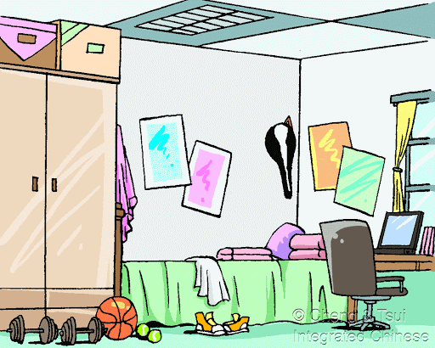
说说看，你看到了什么？
Can you say where the things are in the picture in Chinese?

