Slide 1
Dì kè: zài fàn guǎnr 第三课：在饭馆儿

Slide 2
味道 wèi dào (taste)
糖 táng
咸 xián (salty)
甜 tián (sweet)
酸 suān (sour)
辣 là (spicy)
很

Slide 3
味道 wèi dào (taste)
柠檬 níng méng
咸 xián (salty)
甜 tián (sweet)
酸 suān (sour)
辣 là (spicy)
很

Slide 4
味道 wèi dào (taste)
辣椒 là jiāo
咸 xián (salty)
甜 tián (sweet)
酸 suān (sour)
辣 là (spicy)
很

Slide 5
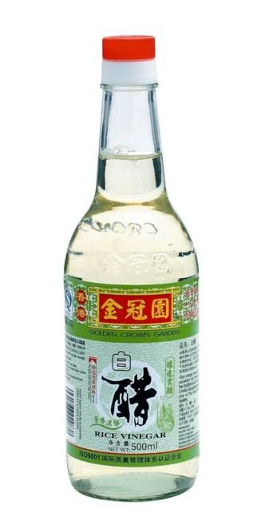
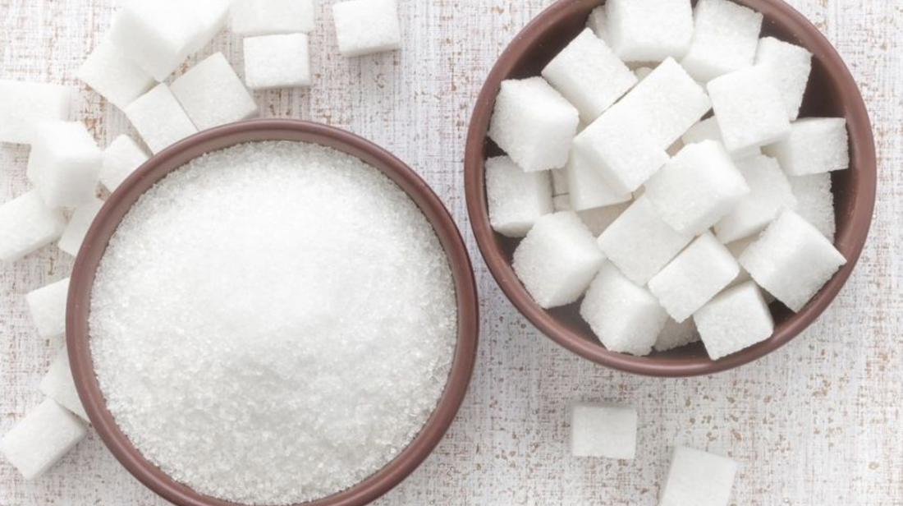
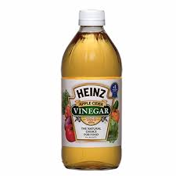
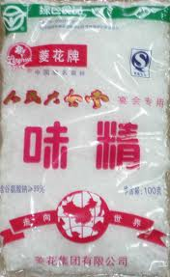
调味料 Tiáowèi liào (Seasoning)
糖 táng
盐 yán
醋 cù
味精 wèijīng

Slide 6
调味料 Tiáowèi liào (Seasoning)
白胡椒
黑 hú jiāo
酱油
Jiàng yóu
辣椒酱
Là jiāo jiàng

Slide 7
饮食喜好或限制 yǐnshí xǐhào huò xiànzhì (Dietary Preferences and restrictions)
Qǐng fàng shǎo yī diǎnr yán
请 放少一点儿盐!
Please put less salt!
xiē
些some
qǐng shǎo fàng yī diǎnr
盐,请 少放一点儿！

Slide 8
饮食喜好或限制 yǐnshí xǐhào huò xiànzhì (Dietary Preferences and restrictions)
Qǐng bié fàng wèijīng
请别放味精!
Please don’t put MSG!

Slide 9
放 fàng ( put; place) verb 些 xiē (some) measure word for an indefinite amount
Qǐng fàng duō yīxiē
请放多一点儿/一些
Qǐng bùyào fàng tài duō
请不要放太多
Qǐng bié fàng
请别放_____！
bīng冰
Shǎo
少

Slide 10
葱Cōng 姜jiāng 蒜suàn

Slide 11
清蒸Qīngzhēng 红烧hóngshāo 炒chǎo

Slide 12
清蒸
红烧
炒
清淡
油
To steam
To braise in soy sauce
To fry
Light in flavor
oil
新鲜
嫩
香
口味
味道
fresh
tender
fragrant;
Taste; dietary preference
Taste; flavor

Slide 13
菜单
餐巾
门口
留学生
叫/点（菜）
流口水
考虑
不如
比如
各
主意
càidān
cānjīn
ménkǒu
liúxué sheng
jiào/diǎn (cài)
liú kǒushuǐ
kǎolǜ
bùrú
bǐrú
gè
zhúyi
Menu
napkin
doorway; entrance
student study abroad
to order (food)
to flow saliva
to consider
inferior to
for example
each; every
idea

Slide 14
四川-川
Sìchuān chuān
广东-粤
Guǎngdōng yuè
山东-鲁
Shāndōng lǔ
江苏-苏
Jiāngsū sū

Slide 15
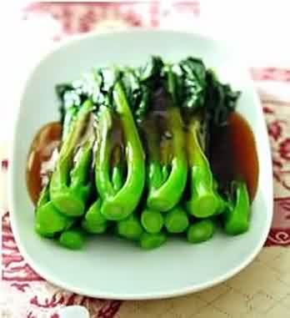
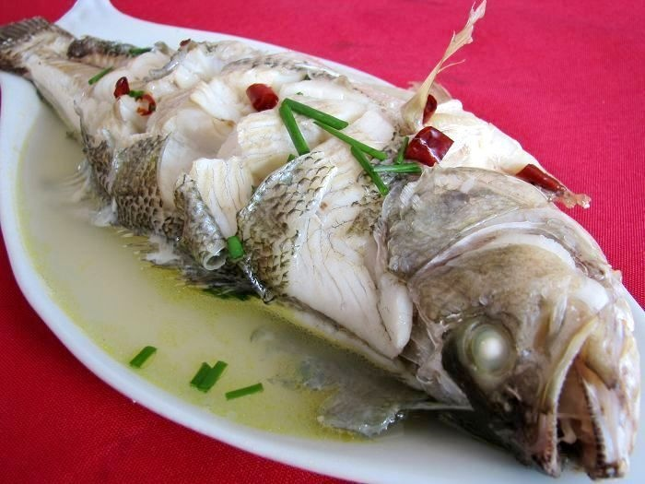
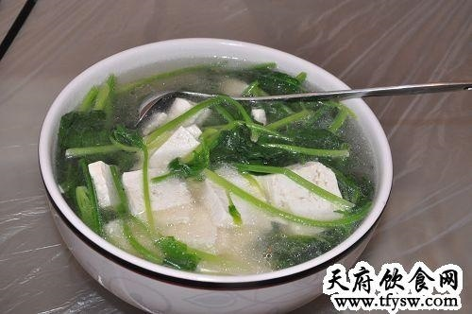
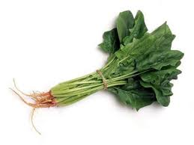
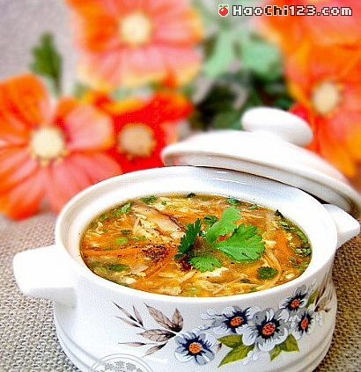
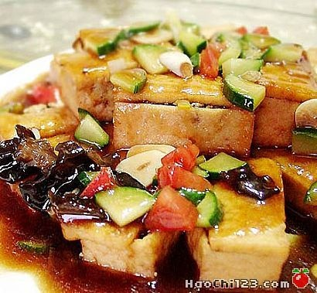
清蒸鱼 qīngzhēng yú
芥兰牛肉 jiè lán niúròu
菠菜豆腐汤 bōcài dòufu tāng
家常豆腐 jiācháng dòufu
酸辣汤 suān là tāng

Slide 16
清蒸
红烧
清淡
油
咸
辣
酸
嫩
香
新鲜
口味
味道
qīngzhēng
hóngshāo
qīngdàn
yóu
xián
là
suān
xīnxian
nèn
xiāng
kǒuwèi
wèidao
To steam (food without heavy sauce)
To cook (food with soy sauce)
Light in flavor
oil; oily
salty
spicy
sour
tender
fragrant; pleasant-smelling
fresh
Taste; dietary preference
Taste; flavor

