Slide 1

Dì kè: Wèn lù
第十三课：问路 Lesson Thirteen: Asking Directions

Slide 2
Duì huà yī Nǐ yào qù nǎ lǐ
对话一：你要去哪里？Where Are You Off To?

Slide 3
Duì huà èr Qù Zhōng Guó Chéng
对话二：去中国城 Going to China Town

Slide 4
Dì kè: Wèn lù
第十三课：问路 Lesson Thirteen: Asking Directions
LEARNING OBJECTIVES:
In this lesson, you will learn to use Chinese to
Ask for and give directions;
Identify locations by using landmarks as references;
Describe whether two places are close to or far away from one another;
State where you are heading and the purpose of going there.

Slide 5
Dì kè: Wèn lù
第十三课：问路 Lesson Thirteen: Asking Directions
Forms & Accuracy:
Direction and Location Words
Comparative Sentences with 没(有)(méi{yǒu})
那 (nàme) Indicating Degree
到 (dào) + Place + 去 (qù) + Action
The Dynamic Particle 过 (guo)
Reduplication of Verbs
Resultative Complements(II)
一…就 (yì…jiù..., as soon as... Then...)

Slide 6
Direction and Location Words
上/下/前/后/左/右/东/南/西/北/里/外/旁
shàng/xià/qián/hòu/zuǒ/yòu/dōng/nán/xī/běi/lǐ/wài/páng
The above direction and location words often combine with suffixes 边 biān, 面 miàn, and 头 tóu.

Slide 7
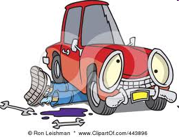
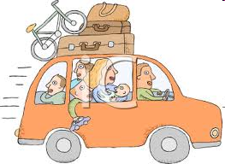
Suffixes 边 biān/面 miàn/头 tóu
top
上边/面/头
Shàng bian/mian/tou
bottom
下边/面/头
Xià bian/mian/tou

Slide 8


Suffixes 边 biān/面 miàn/头 tóu
front
前边/面/头
Qián bian/mian/tou
back
后边/面/头
Hòu bian/mian/tou

Slide 9
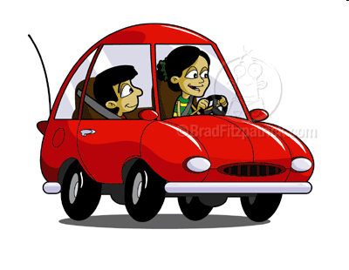
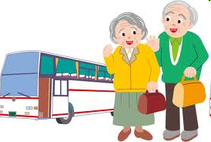
Suffixes 边 biān/面 miàn/头 tóu
inside
里边/面/头
Lǐ bian/mian/tou
outside
外边/面/头
wài bian/mian/tou

Slide 10


Suffixes 边 biān/面 miàn/头 tóu
left side
左边/面
Zǒu bian/mian
right side
右边/面
Yòu bian/mian

Slide 11

Suffixes 边 biān/面 miàn/头 tóu
东边/面 Dōng bian/mian (east side)
西边/面 Xī bian/mian (west side)
南边/面 Nán bian/mian (south side)
北边/面 Běi bian/mian (north side)

Slide 12
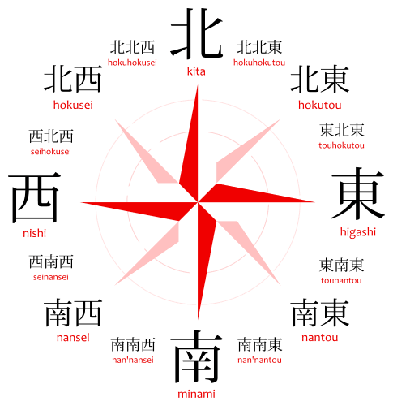
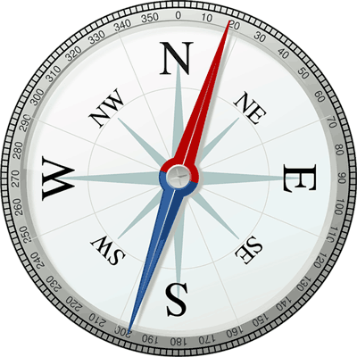
东dōng (East)、南nán (South)、西xī (West)、北běi (North)

Slide 13
东dōng (East)、南nán (South)、西xī (West)、北běi (North)
向东走 Xiàng dōng zǒu (Go east; Walk eastward)
向西走
向南走
向北走
往

Slide 14
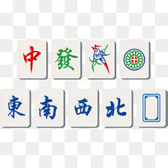
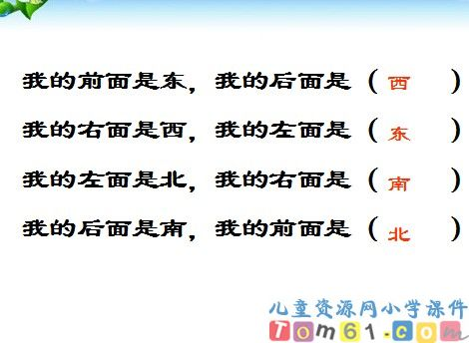
东dōng (East)、南nán (South)、西xī (West)、北běi (North)
折纸：东南西北
https://www.youtube.com/watch?v=JQmiJ-uN_dQ

Slide 15
前qián (front)、后hòu (back)、左zuǒ (left)、右yòu (right)
向前走 Xiàng qián zǒu (Go forward; heading forward)
向后走 Xiàng hòu zǒu (go to the back)
向左走 xiàng zuǒ zǒu (go to the left side; toward left)
向右走 xiàng yòu zǒu

Slide 16
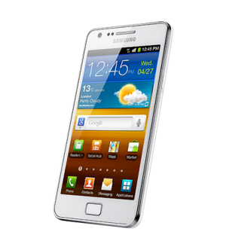
shǒu jī zài nǎ lǐ
Q: 我的手机在哪里？
Where is my cellphone?
A：你的手机在桌子上面/下面。
Nǐ de shǒujī zài zhuōzi shàng miàn/xià miàn
Your cellphone is on (top of )/under the table.

Slide 17
Q: 鸡蛋在哪里？
Jī dàn zài nǎ lǐ
Where is the egg?
A: 鸡蛋在桌子上面。
Jī dàn zài zhuōzi shàng miàn
Your cellphone is on the table
上/下/前/后/左/右/里/外/旁
shàng/xià/qián/hòu/zuǒ/yòu/lǐ/wài/pang
suffixes 边 biān, 面 miàn

Slide 18
Q: 他坐在哪儿？
Tā zuò zài nǎ'er
Where is he sitting?
A：他坐在老师前面/后面/左边/右边/旁边。
Tā zuò zài lǎoshī
He is sitting in front of/in the back of/on the left side/on the right side/next to the teacher.

Slide 19
猜猜看谁在外面？Guess who is outside?
Q: 谁在外面？
Shéi zài wài miàn
Who is outside?
A：__在外面。
zài wàimiàn

Slide 20
猜猜看什么在里面？Guess what’s inside?
Q: 什么在里面？
Shénme zài lǐ miàn
What is inside
A：____在里面。
zài lǐ miàn

Slide 21
猜猜看什么在里面？Guess what’s inside?
Q: 里面有什么？
Shénme zài lǐ miàn
What is there inside？
A：里面有____。
Lǐ miàn yǒu
There is ______ inside.

Slide 22
去哪儿 go where ? /上哪儿
        Nǐ qù nǎr
        Q：你去哪儿？
        Where are you going?
        qù yùndòngchǎng
        A：我去运动场。
        I am going to the Sports Field.

Slide 23
上哪儿去?
        Nǐ nǎr
        Q：你上哪儿去？
        Where are you going?
        yùndòngchǎng
        A：我上运动场去。
        I am going to the Sports Field.

Slide 24
在哪里 Where ? /在什么地方 dì fāng (place)
        Q：你知道学校图书馆在哪里吗？
        Nǐ zhīdào xuéxiào túshūguǎn zài nǎ lǐ ma
        Do you know where is the school library?
        A：学校图书馆在电脑中心旁边。
        Xuéxiào túshūguǎn zài diànnǎo zhōngxīn pángbiān
        The school library is next to the Computer Center.

Slide 25
在哪里 Where ? /在什么地方 dì fāng (place)
        Q：你知道学校图书馆在什么地方吗？
        Nǐ zhīdào xuéxiào túshūguǎn zài shénme dìfāng ma
        Do you know where is the school library?
        A：学校图书馆在电脑中心旁边。
        Xuéxiào túshūguǎn zài diànnǎo zhōngxīn pángbiān
        The school library is next to the Computer Center.

Slide 26
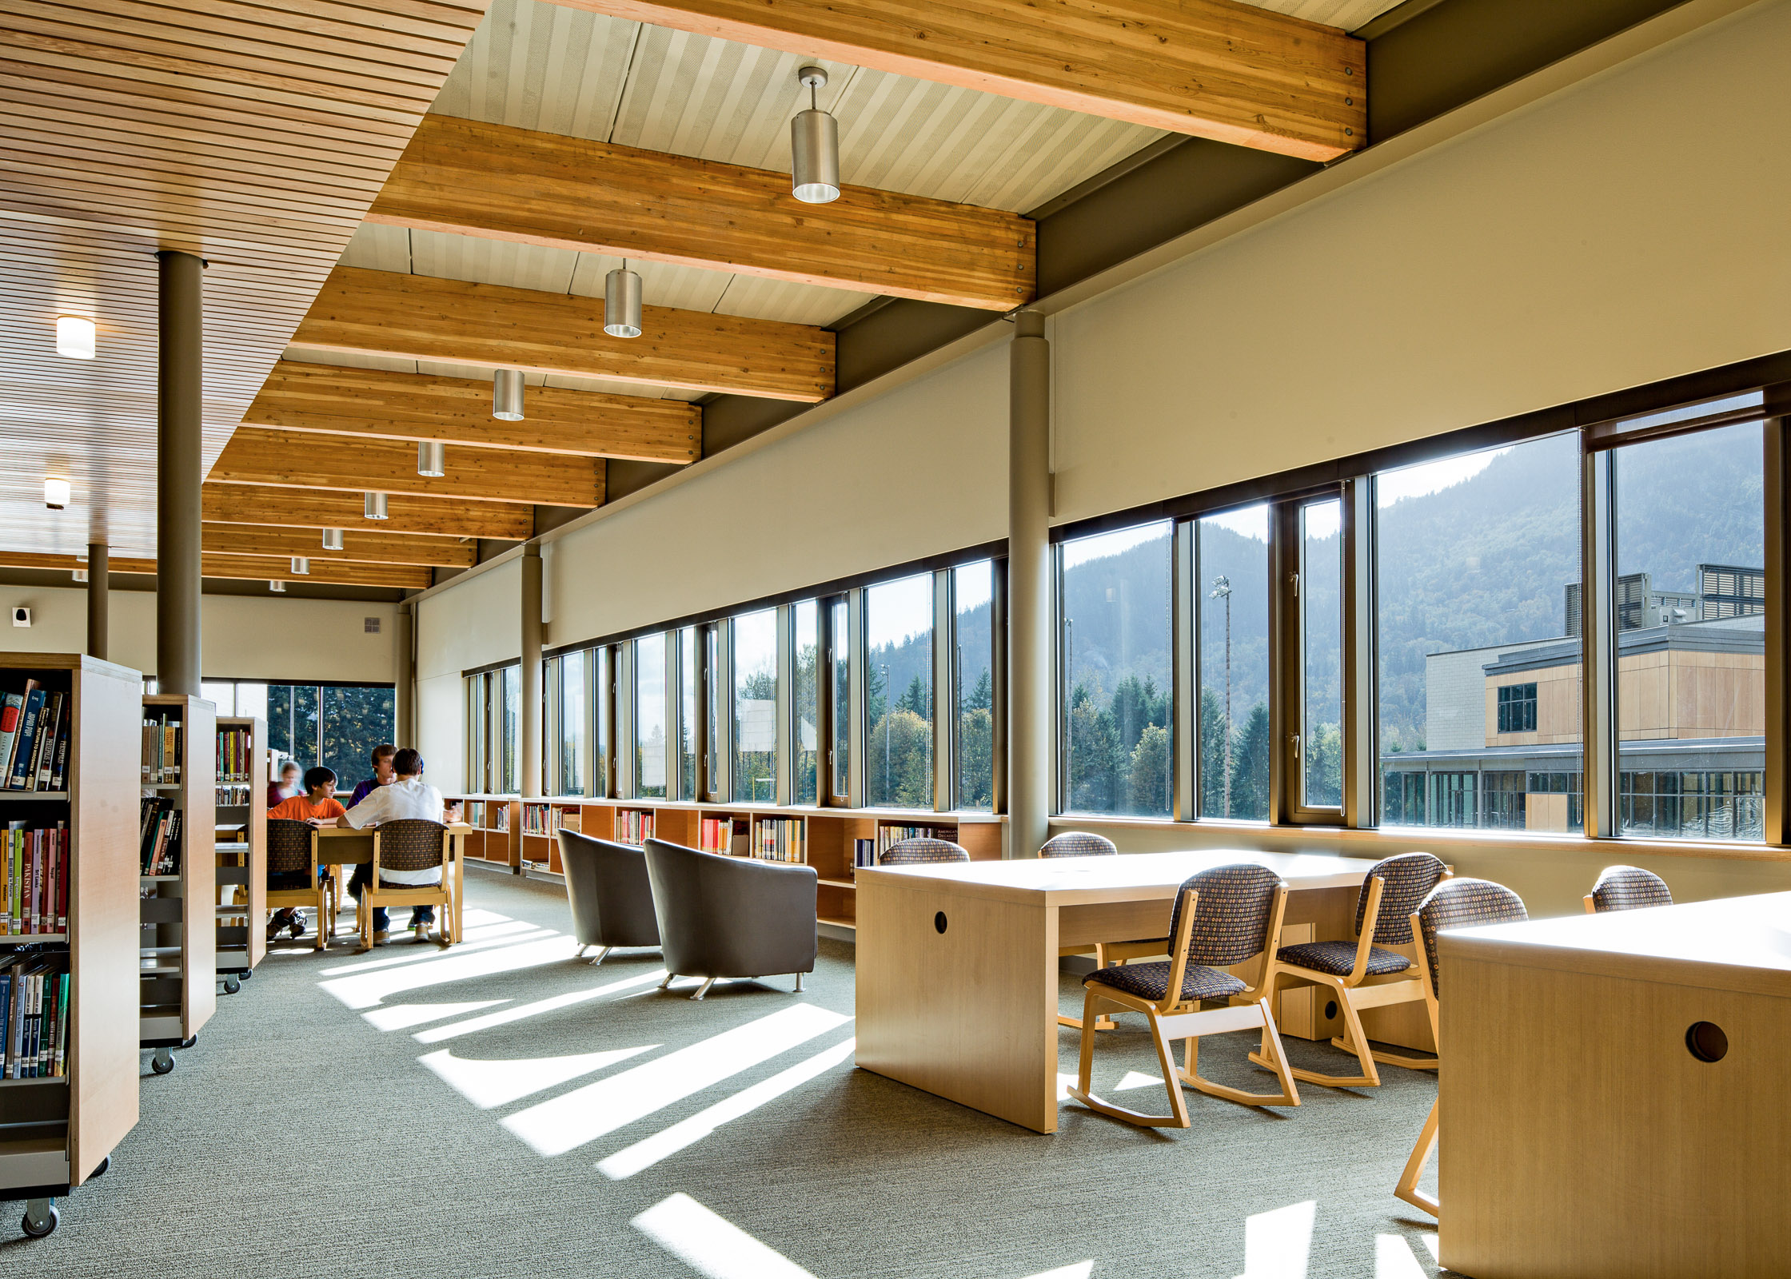
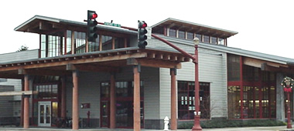
图书馆 Túshū guǎn (library)

Slide 27
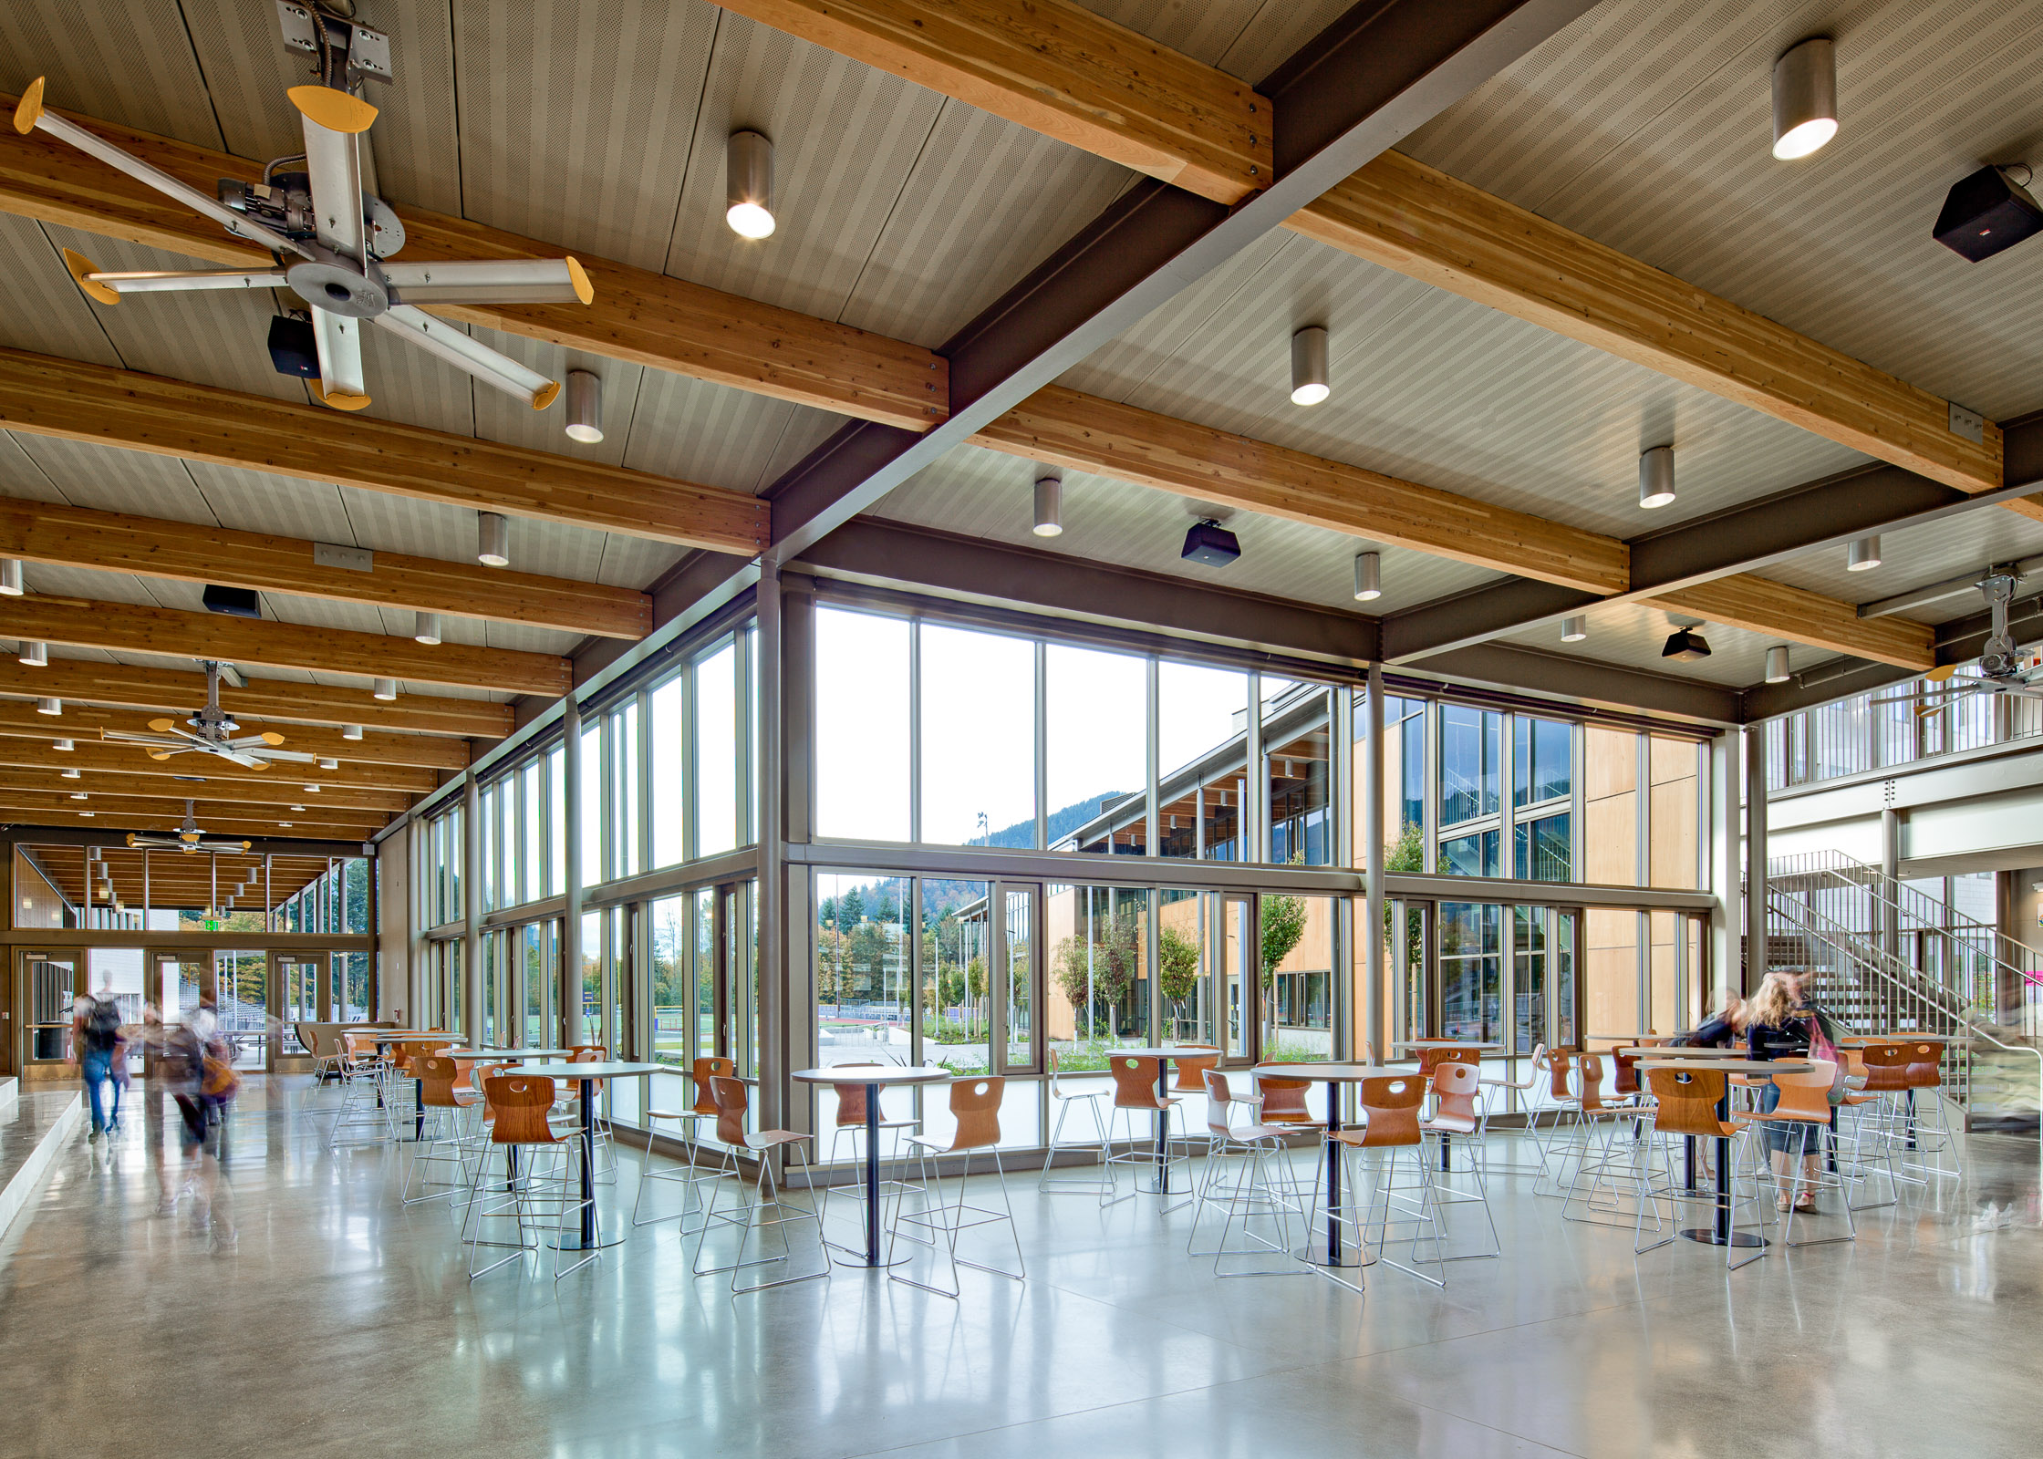
学生活动 huó dòng 中心 (Activity Center)

Slide 28
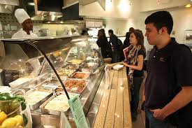
学生餐厅 xué sheng cān tīng (cafeteria) noun

Slide 29
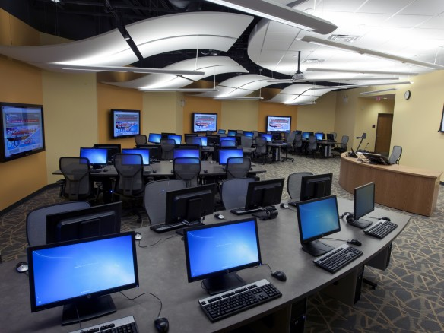
电脑中心 diàn nǎo zhōng xīn (Computer Lab)

Slide 30
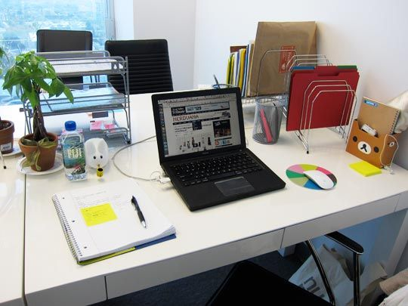
办公室 bàn gōng shì (office)

Slide 31

教室 jiào shì (Classroom) noun

Slide 32
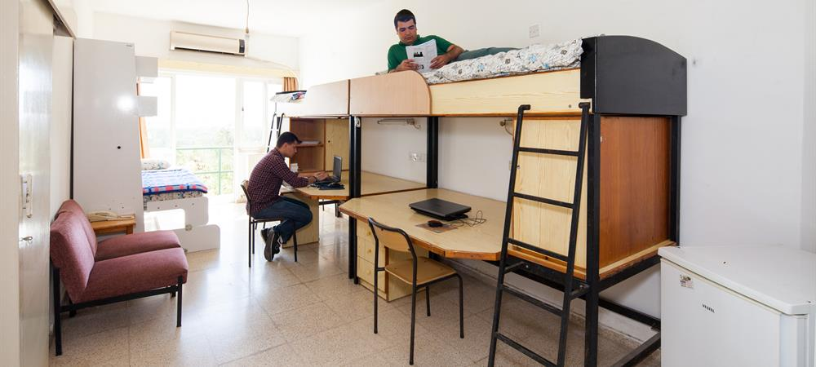
宿舍 sù shè (Dormitory)

Slide 33
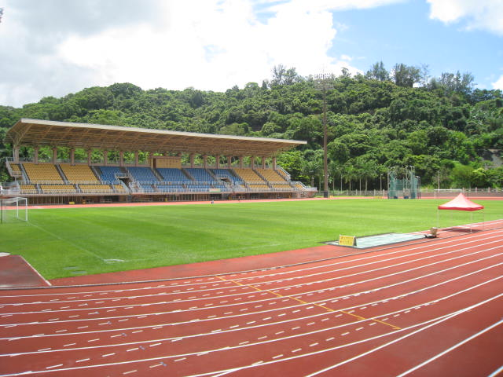
运动场 yùn dòng cháng (Sports Field)

Slide 34
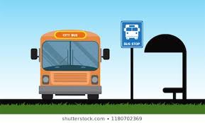
公共汽车站 gōng gòng qì chē zhàn (Bus Stop)

Slide 35

医院 yī yuàn (hospital) Noun

Slide 36
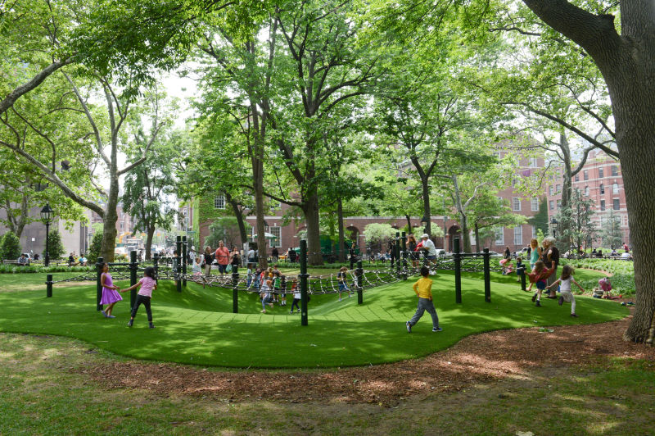
公园 gōng yuán (Park)

Slide 37

商店 shāng diàn

Slide 38

书店 shū diàn (Bookstore)

Slide 39

花店 huā diàn

Slide 40

咖啡店 diàn

Slide 41
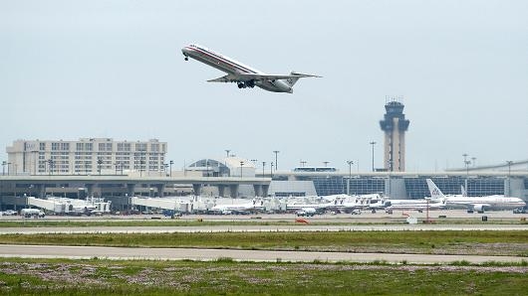
飞机场 fēi jī cháng (AirPort)

Slide 42
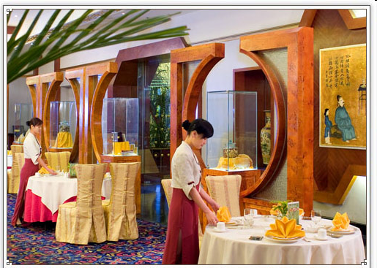
餐馆cān guǎn／饭馆儿fànguǎn(r) (restaurant)

Slide 43
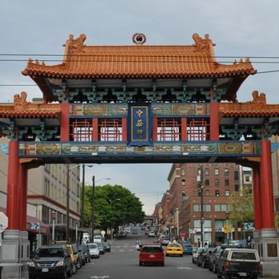
中国城 zhōng guó chéng (China Town)

Slide 44

家 jiā (home)

Slide 45
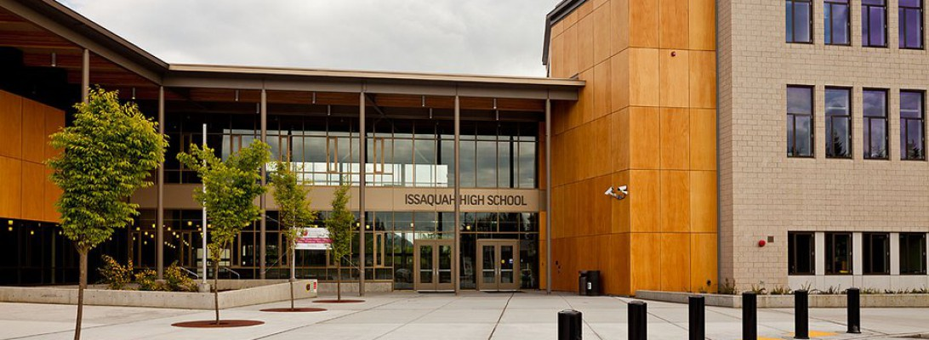
学校 xué xiào (school)

Slide 46
运动场 yùn dòng cháng (Sports Field)
        dào yùn dòng cháng zuò shénme
        Q：你到运动场做什么？
        Wǒ yào dào qù yùn dòng
        A：我要到运动场去运动。
        I want to go to the Sports Field to exercise.

Slide 47
电脑中心 diàn nǎo zhōng xīn (Computer Lab)
        dào diàn nǎo zhōng xīn zuò shénme
        Q：你到电脑中心做什么？
        Wǒ yào dào qù shàng wǎn
        A：我要到电脑中心去上网。
        I want to go to the Computer Lab to surf internet.

Slide 48
图书馆 Túshū guǎn (library)
        dào túshū guǎn zuò shénme
        Q：你到图书馆做什么？
        Wǒ yào dào qù kànshū
        A：我要到图书馆去看书。
        I want to go to the library to read books.

Slide 49
到+ place 去 + action
        Q：你上哪儿去？
        Nǐ shàng nǎ'er qù
        Where are you going?
        A：我要到运动场去打球。
        Wǒ yào dào yùndòngchǎng qù dǎqiú
        I am going to the Sports Field to play ball.

Slide 50
到+ place 去 + action
        Q：你上哪儿去？
        Nǐ shàng nǎ'er qù
        Where are you going?
        A：我要到电脑中心去上网。
        Wǒ yào dào diànnǎo zhōngxīn qù shàngwǎng
        I want to go to the Computer Lab to surf internet.

Slide 51
离 lí Away from (preposition)
远 yuǎn far (Adjective)
近 jìn near (Adjective)
        Nǐ jiā lí túshū guǎn jìn ma
        Q：你家离图书馆近吗？ Is your home close to the library?
        Wǒ jiā lí hěn jìn
        A：我家离图书馆很近。 My home is close to the library.

Slide 52
离 lí Away from (preposition)
        lí túshū guǎn jìn ma
        Q：你家离图书馆近吗？
        Is your home close to the library?
        lí hěn jìn hěn yuǎn
        A1：我家离图书馆很近/很远。
        lí jìn yuǎn
        A2：我家离图书馆不近/不远。
        My home is not close to/far from the library.

Slide 53
离 lí Away from (preposition)
        Bàngōngshì lí túshū guǎn jìn ma
        Q：办公室离图书馆近吗？
        Is the office close to the library?
        Bàngōngshì lí túshū guǎn hěn jìn
        A：办公室离图书馆很近。

Slide 54
离 lí Away from (preposition)
        Yùndòngcháng lí túshū guǎn jìn ma
        Q：运动场离图书馆近吗？
        Is the sport field close to the library?
        Yùndòngcháng lí túshū guǎn hěn yuǎn
        A：运动场离图书馆很远。
        The sport field is far from the library.

Slide 55
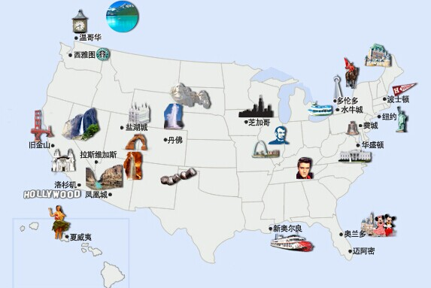
离 lí Away from (preposition)
        Niǔyuē lí wǒmen zhè’er yuǎn ma
        Q：纽约离我们这儿远吗？
        Is New York from from our location?
        Niǔyuē lí wǒmen zhè’er hěn yuǎn
        A:纽约离我们这儿很远。
        New York is from from our location.

Slide 56
Using 没有 lí (not as… ) to make a comparison
        我没有他高。（他比我高。）
        Wǒ méiyǒu tā gāo. Tā bǐ wǒ gāo
        北京没有上海热。（上海比北京热。）
        Běijīng méiyǒu shànghǎi rè. Shànghǎi bǐ běijīng rè
        教室没有运动场远。
        Jiàoshì méiyǒu yùndòngchǎng yuǎn

Slide 57
Using 那么 nàme (… ) to indicate degree
        我没有他那么高。 I am not as tall as he is.
        Wǒ méiyǒu tā nàme gāo.
        北京没有上海那么热。
        Běijīng méiyǒu shànghǎi nàme rè.
        教室没有运动场那么远。
        Jiàoshì méiyǒu yùndòngchǎng nàme yuǎn.
        没有…那么 means “not reaching a point of “

Slide 58
Using 那么 nàme (… ) to indicate degree
        你那么会说中文，你教我说中文。
        Nǐ nàme huì shuō zhōngwén, nǐ jiào wǒ shuō zhōngwén.
        你那么想看电影，我们明天去看电影。
        Nǐ nàme xiǎng kàn diànyǐng, wǒmen míngtiān qù kàn diànyǐng.
        你那么喜欢打球，我们一起去打球吧。
        Nǐ nàme xǐhuān dǎqiú, wǒmen yīqǐ qù dǎqiú ba.

Slide 59
听说 tīng shuō (to be told; to hear of) verb
        听说西雅图很冷。
        Tīng shuō xīyǎtú hěn lěng
        I heard that Seattle is cold.
        听说 Apex 很好玩儿。
        I heard that Apexis very fun to play with.
        听说 Captain Marvel 很好看。
        I heard that Apexis very fun to play with.

Slide 60
听说 tīng shuō (to be told; to hear of) verb
        Wǒ tīng shuō nǐ chàng zhōngwén gē chàng dé hěn hǎo
        我听说你唱中文歌唱得很好。
        I heard that you sing Chinese songs very well.
        Nǐ tīng shuō le ma, tā nǚ péngyǒu hěn piàoliang
        你听说了吗，他女朋友很漂亮。
        Have you heard of it that his girl friend is very pretty.

Slide 61
听说 tīng shuō (to be told; to hear of) verb
        A: 听说图书馆在电脑中心旁边。
        Tīng shuō túshūguǎn zài diànnǎo zhōngxīn pángbiān
        I heard that the library is next to the Computer Center.
        B: 图书馆没有电脑中心那么远。
        Túshūguǎn méiyǒu diànnǎo zhōngxīn nàme yuǎn
        The library is not as far as the Computer Center.

Slide 62
去哪儿 go where ? /上哪儿
        Nǐ qù nǎr
        Q：你去哪儿？
        Where are you going?
        qù yùndòngchǎng
        A：我去运动场。
        I am going to the Sports Field.

Slide 63
上哪儿去?
        Nǐ shàng nǎr qù
        Q：你上哪儿去？ Where are you going?
        yùndòngchǎng
        A：我上运动场去。I am going to the Sports Field.

Slide 64
在哪里 Where ? /在什么地方 dì fāng (place)
        Q：你知道学校图书馆在哪里吗？
        Nǐ zhīdào xuéxiào túshūguǎn zài nǎ lǐ ma
        Do you know where is the school library?
        A：学校图书馆在电脑中心旁边。
        Xuéxiào túshūguǎn zài diànnǎo zhōngxīn pángbiān
        The school library is next to the Computer Center.

Slide 65
在哪里 Where ? /在什么地方 dì fāng (place)
        Q：你知道学校图书馆在什么地方吗？
        Nǐ zhīdào xuéxiào túshūguǎn zài shénme dìfāng ma
        Do you know where is the school library?
        A：学校图书馆在电脑中心旁边。
        Xuéxiào túshūguǎn zài diànnǎo zhōngxīn pángbiān
        The school library is next to the Computer Center.

Slide 66
离 lí Away from (preposition)
远 yuǎn far (Adjective)
近 jìn near (Adjective)
        Nǐ jiā lí túshū guǎn jìn ma
        Q：你家离图书馆近吗？ Is your home close to the library?
        Wǒ jiā lí hěn jìn
        A：我家离图书馆很近。 My home is close to the library.

Slide 67
离 lí Away from (preposition)
        lí túshū guǎn jìn ma
        Q：你家离图书馆近吗？
        Is your home close to the library?
        lí hěn jìn hěn yuǎn
        A1：我家离图书馆很近/很远。
        lí jìn yuǎn
        A2：我家离图书馆不近/不远。
        My home is not close to/far from the library.

Slide 68
离 lí Away from (preposition)
        Bàngōngshì lí túshū guǎn jìn ma
        Q：办公室离图书馆近吗？
        Is the office close to the library?
        Bàngōngshì lí túshū guǎn hěn jìn
        A：办公室离图书馆很近。
        The office is close to the library.

Slide 69
离 lí Away from (preposition)
        Yùndòngcháng lí túshū guǎn jìn ma
        Q：运动场离图书馆近吗？
        Is the sport field close to the library?
        Yùndòngcháng lí túshū guǎn hěn yuǎn
        A：运动场离图书馆很远。
        The sport field is far from the library.

Slide 70
离 lí Away from (preposition)
        Niǔyuē lí wǒmen zhè’er yuǎn ma
        Q：纽约离我们这儿远吗？
        Is New York from from our location?
        Niǔyuē lí wǒmen zhè’er hěn yuǎn
        A:纽约离我们这儿很远。
        New York is from from our location.

Slide 71
Using 没有 lí (not as… ) to make a comparison
        我没有他高。（他比我高。）
        Wǒ méiyǒu tā gāo. Tā bǐ wǒ gāo
        北京没有上海热。（上海比北京热。）
        Běijīng méiyǒu shànghǎi rè. Shànghǎi bǐ běijīng rè
        教室没有运动场远。
        Jiàoshì méiyǒu yùndòngchǎng yuǎn

Slide 72
Using 那么 nàme (… ) to indicate degree
        我没有他那么高。 I am not as tall as he is.
        Wǒ méiyǒu tā nàme gāo.
        北京没有上海那么热。
        Běijīng méiyǒu shànghǎi nàme rè.
        教室没有运动场那么远。
        Jiàoshì méiyǒu yùndòngchǎng nàme yuǎn.
        没有…那么 means “not reaching a point of “

Slide 73
Using 那么 nàme (… ) to indicate degree
        你那么会说中文，你教我说中文。
        Nǐ nàme huì shuō zhōngwén, nǐ jiào wǒ shuō zhōngwén.
        你那么想看电影，我们明天去看电影。
        Nǐ nàme xiǎng kàn diànyǐng, wǒmen míngtiān qù kàn diànyǐng.
        你那么喜欢打球，我们一起去打球吧。
        Nǐ nàme xǐhuān dǎqiú, wǒmen yīqǐ qù dǎqiú ba.

Slide 74
运动场 yùn dòng cháng (Sports Field)
        Nǐ dào yùn dòng cháng zuò shénme
        Q：你到运动场做什么？
        What do you do to go to the Sports Field?
        Wǒ yào dào yùn dòng cháng qù yùn dòng
        A：我要到运动场去运动。
        I want to go to the Sports Field to exercise.

Slide 75
电脑中心 diàn nǎo zhōng xīn (Computer Lab)
        Nǐ dào diàn nǎo zhōng xīn zuò shénme
        Q：你到电脑中心做什么？
        What do you do to go to the Computer center?
        Wǒ yào dào diàn nǎo zhōng xīn qù shàng wǎn
        A：我要到电脑中心去上网。
        I want to go to the Computer Lab to surf internet.

Slide 76
一 … 就 jìu As soon as… then
Connects two actions.
Actions types of situations: Habitual or one-time situations.
In a habitual situation, whenever the first action occurs, the second action immediately follows

Slide 77
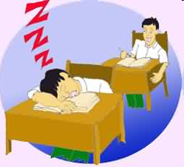
一 … 就 jìu As soon as… then
他一上课就想睡觉。
Tā yí shàng kè jiù xiǎng shuì jiào.
He feels sleepy every time the class starts.

Slide 78
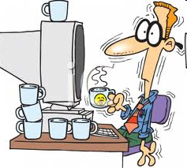
一 … 就 jìu As soon as… then
李律师一累就喝咖啡。
Lǐ lǜshī yí lèi jiù hē kāfēi.
Attorney Li drinks coffee whenever he feels tired.

Slide 79

一 … 就 jìu As soon as… then
我们一进饭馆儿，服务员就告诉我们没位子了。
Wǒmen yí jìn fànguǎnr, fúwùyuán jiù gàosù wǒmen méi wèizi le.
As soon as we got into the restaurant,
the waiter told us there were no seats available.

Slide 80

一 … 就 jìu As soon as… then
这课的语法很容易，我一看就懂。
Zhè kè de yǔfǎ hěn ròngyì, wǒ yí kàn jiù dǒng.
The grammar in this lesson was very easy.
I understood it the moment I read it.

Slide 81
一 … 就 jìu As soon as… then
我 一 喝啤酒 就 不舒服
北京 一 到秋天 就 下雨
我 一 睡觉 小高 就
爸爸 一 回家 就
你往左 一 拐 就

Slide 82
次 cì (measure word for frequency)
请再说一次／遍。 Please say it again.
Qǐng zàishuō yīcì/biàn
他说了几次？ How many times did he say?
Tā shuōle jǐ cì
她练习写了几次？How many times did she practice writing?
Tā liànxí xiěle jǐ cì?
他上了几次厕所？How many times did he go to the restroom?
Tā shàngle jǐ cì cèsuǒ?

Slide 83

拿 ná (to take; to get)
请不要拿我的手机。
Qǐng bùyào ná wǒ de shǒujī
Please don‘t take my phone。
请不要拿我的钱。
Qǐng bùyào ná wǒ de qián
Please don‘t take my money.

Slide 84

哎 āi Exclamatory particle
To express surprise or dissatisfaction

Slide 85
Chinese & English Exclamations (Interjections)
呀！ Ya
啊?！A
喂? Wéi
Ah!
Ha!
Boo!
Duh
Gee!
Hey!
Wow!
Yikes!

Slide 86

日本 Rìběn Japan

Slide 87

日文 Rìwén Japanese (Language)

Slide 88
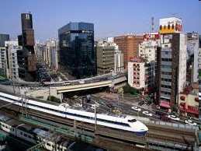
东京 Dōngjīng Tokyo

Slide 89
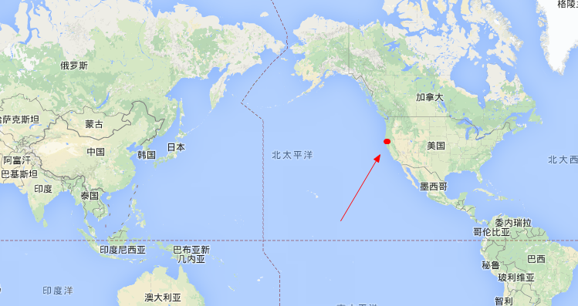
地图 dìtú (map)

Slide 90
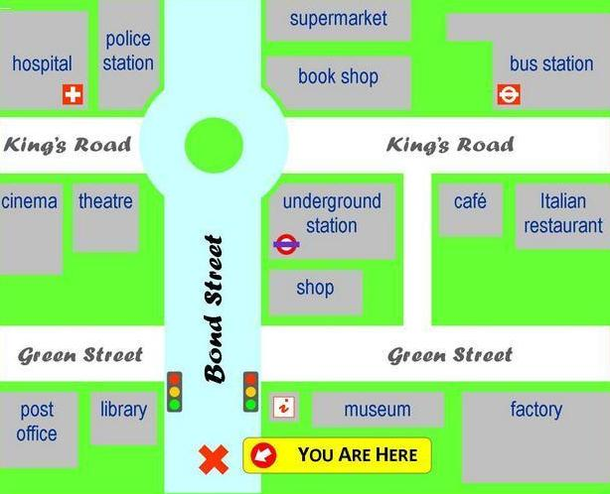
地图 dìtú (map)

Slide 91
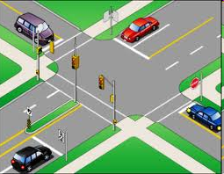
路口 lùkǒu (intersection)

Slide 92

红绿灯 hónglǜdēng (traffic light)

Slide 93
问路 wèn lù (Asking directions)
到学生活动中心怎么走？
Dào xuéshēng huódòng zhōngxīn zěnme zǒu
How to get to the student activity center from here?
从书店到运动场怎么走？
Cóng shūdiàn dào yùndòngchǎng zěnme zǒu
How to go from the bookstore to the playground?

Slide 94
怎么 zěnme (how)
        怎么样yàng？ How about…
        怎么办bàn？ How/What to do
        怎么写xiě？ How to write
        怎么唱chàng？ How to sing…
        怎么走zǒu？ How to walk to/How to walk
        https://www.youtube.com/watch?v=xk-HUhhD8R0&list=PLkvG4EWPDB0lJ6yTXj8VShh2cdE828Hx6&index=7

Slide 95
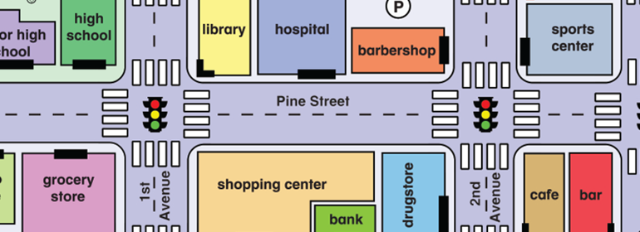
问路 wèn lù (Asking directions)
从这儿一直往前走。 Cóng zhè'er yīzhí wǎng qián zǒu

Slide 96
从 cóng from (preposition)
Q: 你从哪里来？
Nǐ cóng nǎlǐ lái?
Where did you come?
A: 我从家里来。
Wǒ cóng jiālǐ lái
I came (here) from home.
Q: 从这里到图书馆怎么走？
Cóng zhèlǐ dào túshū guǎn zěnme zǒu

Slide 97

从 cóng from (prep)
海鸥飞了好远好远，没有人问它从哪里来。
Q：你从哪里来？
A：我从家里来。
Q：从这里到办公室怎么走？

Slide 98
从 cóng from (preposition)
Q:从这里到书店怎么走？
Cóng zhèlǐ dào shūdiàn zěnme zǒu
How to go to the bookstore from here.
A:从这儿一直往前走。
Cóng zhè'er yīzhí wǎng qián zǒu
Go straight ahead from here.

Slide 99

往 wǎng towards (prep)
往前走。 Go forward.
Wǎng qián zǒu
往西走。 Go westward.
Wǎng xī zǒu
往学校走。 Go toward the school.
Wǎng xuéxiào zǒu.

Slide 100
往 wǎng towards (prep)
往前走。
往那儿走。

Slide 101
向 xiàng facing/towards (preposition)
Xiàng zuǒ zhuǎn
向左转
Xiàng yòu zhuǎn
向右转
Xiàng hòu zhuǎn
向后转

Slide 102
东dōng (East)、南nán (South)、西xī (West)、北běi (North)
往东走 Wǎng dōng zǒu (Go east; Walk eastward)
向西走 Wǎng xī zǒu (Go west; Walk westward)
向南走 Wǎng nán zǒu (Go south; Walk southward)
向北走 Wǎng běi zǒu (Go north; Walk northward)

Slide 103

一直 yìzhí straight; continuously (ADV)
一直走
就到了 jìu dào le
不要一直玩手机。
Bùyào yīzhí wán shǒujī
Don‘t keep playing with your phone。
不要一直看电视。
Bùyào yīzhí kàn diànshì
Don't watch TV all the time.

Slide 104
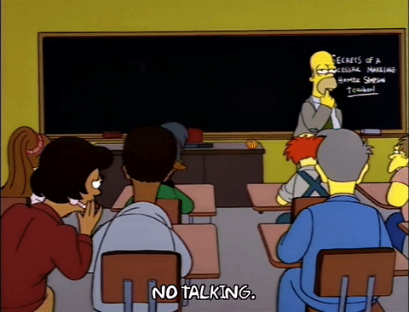
一直 yìzhí straight; continuously (ADV)
不要一直讲话 jiǎng huà。

Slide 105

拐 guǎi to turn (verb)
转 zhuǎn to turn (verb)
拐弯 guǎi wān
左拐 zuǒ guǎi
右拐 yòu guǎi
往右拐 wǎng yòu guǎi

Slide 106
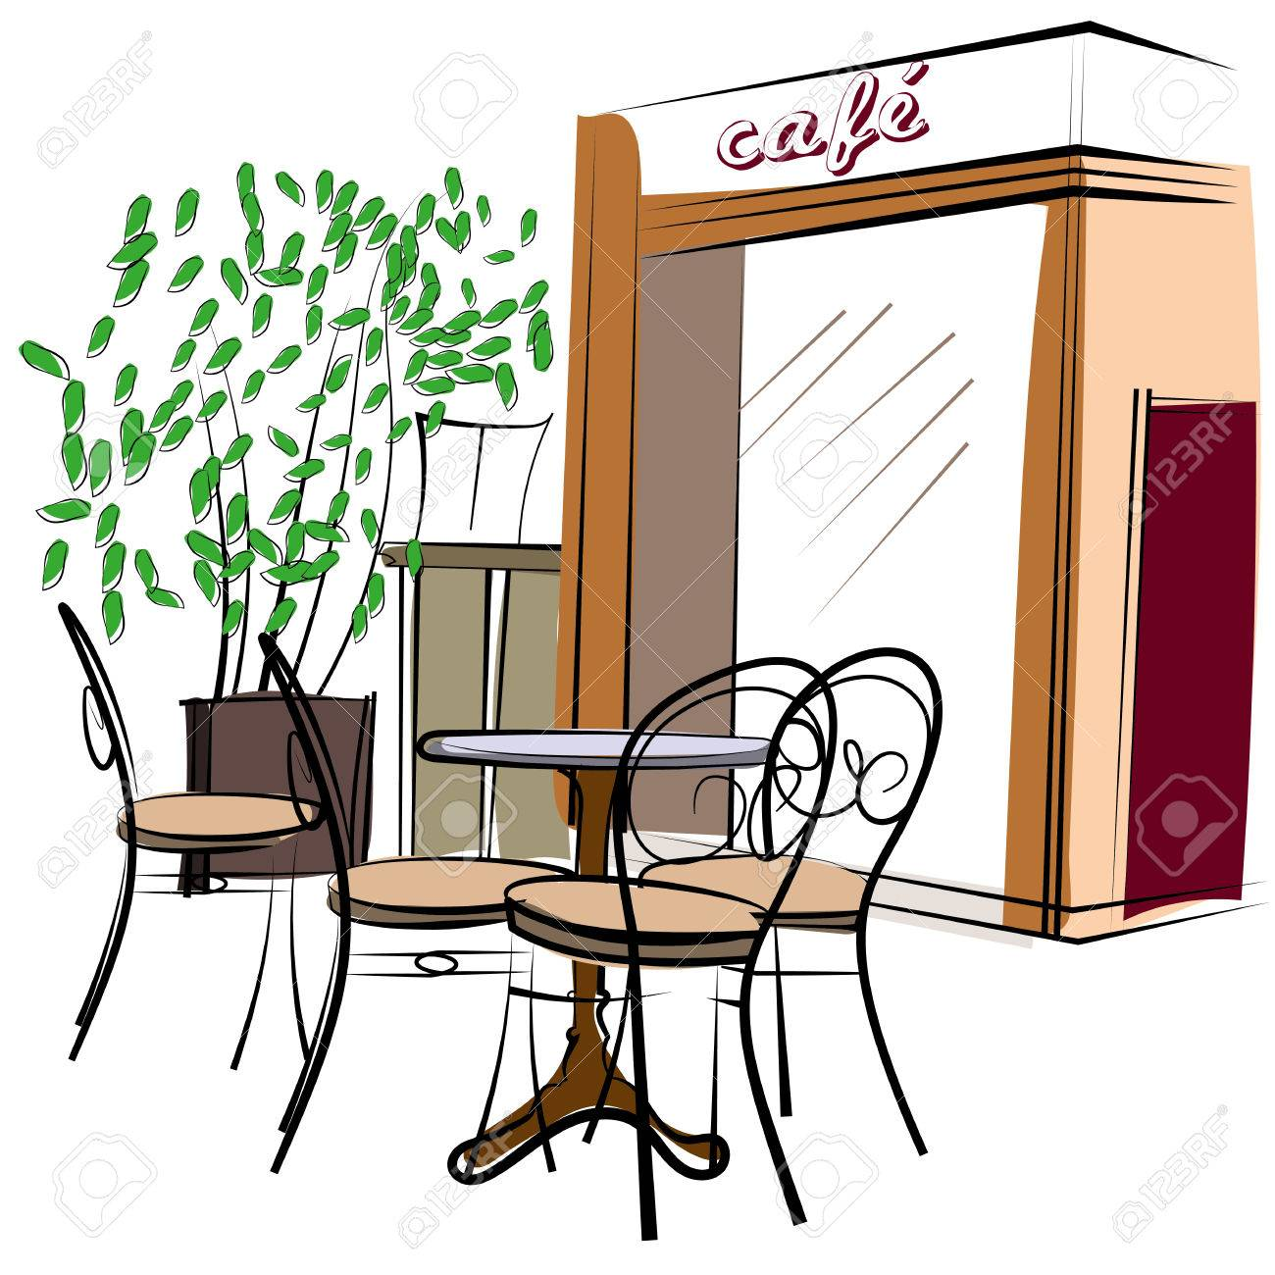

Q:从教室到咖啡厅怎么走？
Cóng jiàoshì dào kāfēi tīng zěnme zǒu
A:从教室往北走，再往左拐，就到了。
Cóng jiàoshì wǎng běi zǒu, zài wǎng zuǒ guǎi, jiù dàole
问路 wèn lù (Asking directions)
北

Slide 107
过 guò (to pass) verb
过了一个路口。 Guòle yīgè lùkǒu
过了两个红绿灯。 Guòle liǎng gè hónglǜdēng

Slide 108
Q:从教室到咖啡厅怎么走？
A:从教室往北走，过第二个路口往左拐。再过两个路口，就到了。
问路 wèn lù (Asking directions)
北

Slide 109
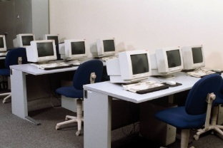
Q:从电影院去电脑中心怎么走？
A:在电影院北边往右拐，
第一个红绿灯往左拐，
过两个路口，
走三分钟，
电脑中心在你的右边。
问路 wèn lù (Asking directions)

Slide 110
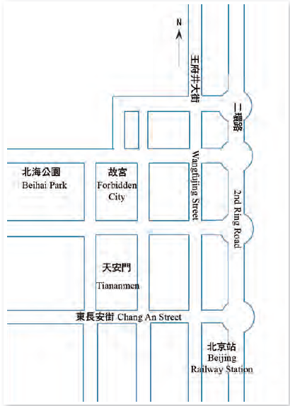
问路 wèn lù (Asking directions)

Slide 111
The Dynamic Particle 过 (guò)
--To denote a past experience
The fact that the speaker worked in Chinatown for a year is the reason why he/she knows how to get there.

Slide 112
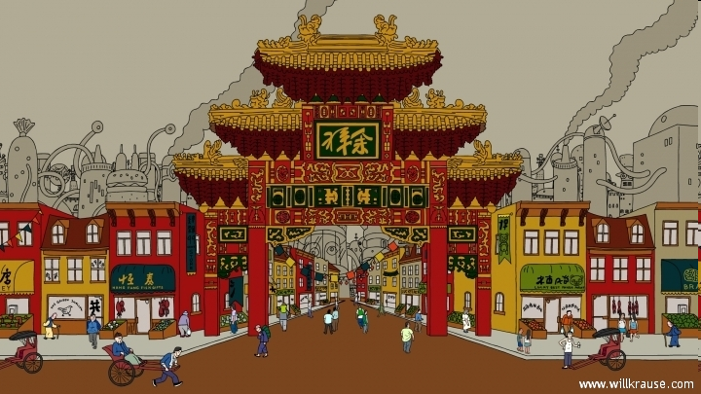
Verb+ 过 (guò) Particle
Q:你去过中国城吗？
A1:我去过中国城。
A2:我没去过中国城。

Slide 113
Verb+ 过 (guò) Particle
Q:你吃过饺子吗？
A1:我吃过。
A2:我没吃过。

Slide 114
Verb+ 过 (guò) Particle
--To denote a past experience
Q:你开过车吗?
A1:我开过车。
A2:我没开过车。

Slide 115
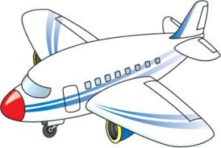
Verb+ 过 (guò) Particle
Q:你坐过飞机吗？
A1:我坐过飞机。
A2:我没坐过。

Slide 116
Verb+ 过 (guò) Particle
Q:你坐过地铁吗？
A1:我坐过地铁。
A2:我没坐过地铁。

Slide 117
说话练习 shuō huà liàn xí Speaking Practice
Tell your classmates about the “interesting experiences you had in your life .”
我去过？
我吃过…
我看过…
我听说过…

Slide 118
The Dynamic Particle 过 (guò)
Ex: Q：你见过李小姐吗？
Nǐ jiàn guò Lǐ xiǎojiě ma?
Have you ever met Miss Li?
A：见过，上个月还见过她。
Jiàn guò, shàng ge yuè hái jiàn guò tā.
Yes. I saw her as recently as last month.
Ex: 我见过李友，(所以知道)她很高。
Wǒ jiàn guò Lǐ Yǒu, (suǒyǐ zhīdào) tā hěn gāo.
I’ve met Li You before, (so I know) she is tall.

Slide 119
The Dynamic Particle 过 (guò)
Ex:我以前去过中国城，所以知道怎么走。
Wǒ yǐqián qù guo Zhōngguóchéng, suǒyǐ zhīdào zěnme zǒu.
I’ve been to Chinatown before. I know how to get there.
Ex:我在中国城工作过一年，我知道怎么走。
Wǒ zài Zhōngguóchéng gōngzuò guo yì nián, wǒ zhīdào zěnme zǒu.
--To denote a past experience
The fact that the speaker worked in Chinatown for a year is the reason why he/she knows how to get there.

Slide 120

Reduplication of Verbs
我用用你的电脑可以吗？
Wǒ yòng yong nǐ de diànnǎo kěyǐ ma?
May I use your computer for a minute?

Slide 121

Reduplication of Verbs
你考完试，我们一起去公园走走，聊聊天儿。
Nǐ kǎo wán shì, wǒmen yìqǐ qù gōngyuán zǒu zou, liáo liao tiānr.
Let’s take a walk in the park
and have a chat after your exam.

Slide 122
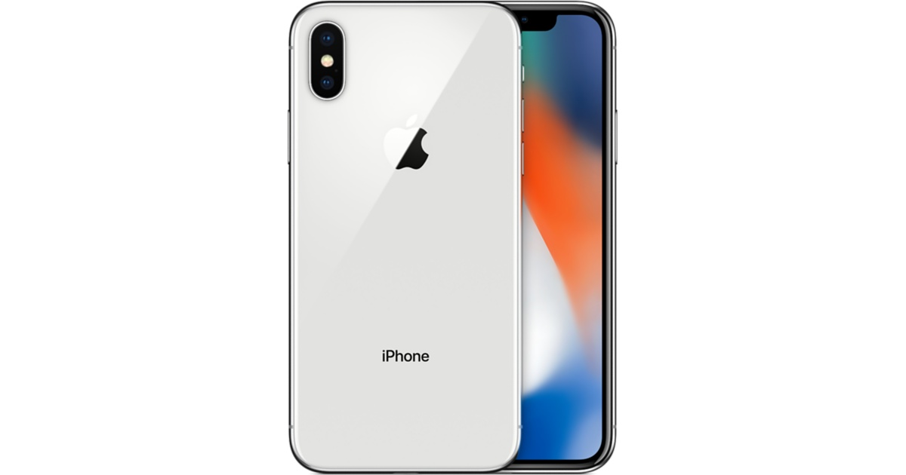
If a sentence includes both a modal verb and an action verb, only the action verb can be reduplicated.
Reduplication of Verbs
她想看看我的新手机。
Tā xiǎng kàn kan wǒ de xīn shǒujī.
She wants to take a look at my new cell phone.

