Slide 1

Dì kè: shēngrì pài duì
第十四课：生日派对 Lesson Fourteen: Birthday Party

Slide 2
Duì huà èr Cānjiā shēngrì pàiduì
对话二：参加生日派对 Attending A Birthday Party

Slide 3
第十四课 学习目标 (Lesson 14 Learning objectives)
    In this lesson, you will learn to use Chinese to
  Ask a friend to go to a party with you;
  Suggest things to take to a get-together;
  Offer someone a ride and arrange a time and place to meet;
  Thank people for their gifts;
  Describe a duration of time;
  Talk about the year of your birth and your Chinese zodiac sign;
  Give a simple description of someone’s facial features.

Slide 4
第十四课 学习目标 (Lesson 14 Learning objectives)
Forms & Accuracy:
呢 (ne) Indicating an Action in Progress
Verbal Phrases and Subject-Predicate Phrases Used as Attributives
Time Duration
Sentences with 是...的(shì...de)
还 (hái, still)
又...又... (yòu...yòu..., both...and...)

Slide 5
第十四课 对话二
Shēng cí
生词
vocabulary

Slide 6

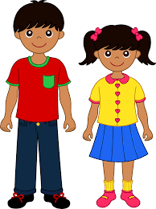
长 cháng (long) adj; zhǎng (to grow; to appear) verb
cháng cháng de
狗的耳朵长长的。
zhǎng de
我妹妹长得很可爱。

Slide 7
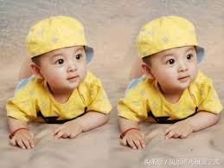
像 xiàng (to be like; to look like; to take after) verb
你长得像妈妈还是像爸爸？
Nǐ zhǎng de xiàng māmā háishì xiàng bàba
Do you look like (your) Mom or (your) Dad?
他们两个长得很像。
Tāmen liǎng gè zhǎng dé hěn xiàng
They look alike.

Slide 8
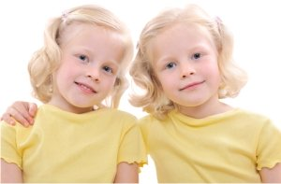
像 xiàng (to be like; to look like; to take after) verb
她们两个长得像吗？
Tāmen liǎng gè zhǎng dé xiàng mā
Do they look alike?

Slide 9
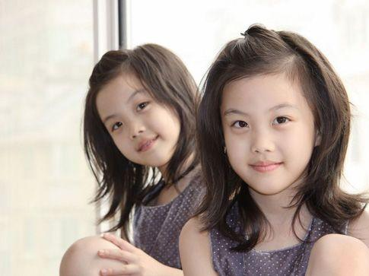
像 xiàng (to be like; to look like; to take after) verb
像吗？
像不像？
像谁？

Slide 10
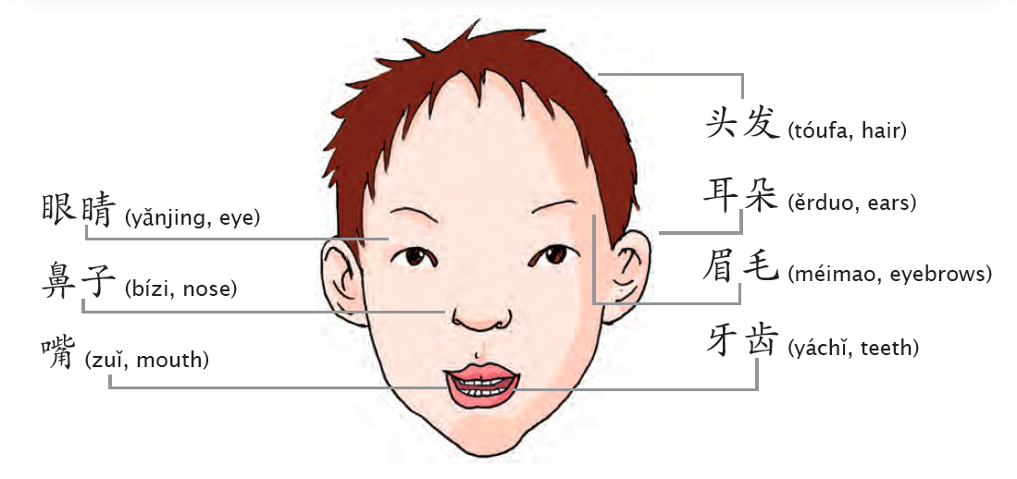
脸 liǎn (face)

Slide 11
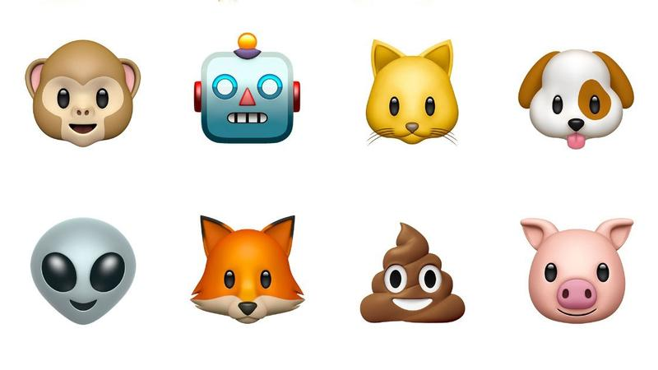
脸 liǎn (face)
Describe facial feature in Chinese：
长长的 cháng
高高的 gāo
圆圆的 yuán
大大的
小小的

Slide 12
长 cháng (long) adj; zhǎng (to grow; to appear) adv
cháng cháng de
狗的耳朵长长的。
zhǎng de
我妹妹长得很可爱。

Slide 13
音乐活动时间 (Total Physical Response & music Time)
头兒肩膀膝腳趾 Head Shoulders Knees&Toes
Tóu er, jiānbǎng, xī jiǎozhǐ, xī jiǎozhǐ
tóu er, jiānbǎng, xī jiǎozhǐ
yǎn, ěr, bí hé kǒu
头儿、肩膀、膝 腳趾、膝 腳趾
头儿、肩膀、膝 腳趾
眼、耳、鼻和口

Slide 14
音乐活动时间 (Total Physical Response & music Time)
头和肩膀（Head Shoulders Knees & Toes）
头和肩膀， 膝和脚， 膝和脚。
头和肩膀， 膝和脚， 膝和脚。
眼睛、耳朵、鼻子、嘴。
yǎnjīng ěrduo bízi zuǐ
头和肩膀， 膝和脚， 膝和脚。

Slide 15
一定 yí dìng certain(ly); definite(ly) adj;adv
一定不一定？
爸爸很帅，儿子一定也很帅？
聪明
Cōng míng
smart

Slide 16
班 bān (the group of students who take a course together)
课 kè (refers to a course or a meeting time for the course)
我 的同学 My classmate
我中文班的同学 My Chinese classmate
我的中文课有三班。 I have three Chinese classes.

Slide 17

以为 yǐwéi (to assume erroneously) verb
It is often used to signify an understanding or judgment which has proved to be erroneous.
Ex: 我以为你吃素。
Wǒ yǐwéi nǐ chī sù
I thought you were a vegetarian.

Slide 18
第十四课 对话二
Yǔ fǎ
语法
grammar

Slide 19
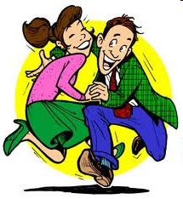
还 hái (still)
Q:你在做什么呢？
A:我在跳舞呢！
三个钟头后… 3 hours later...
Sān gè zhōngtóu hòu
Q:你在做什么呢？
A:我还在跳舞呢！

Slide 20
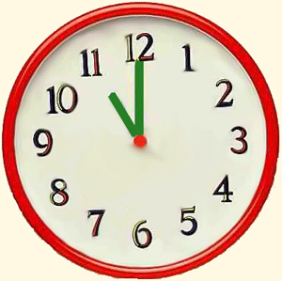
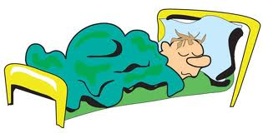
还 hái (still) Adverb
11：00 AM
Q:小高在做什么呢？
A:小高还在睡觉呢！

Slide 21
Time Duration
11：00 PM
11：00 AM
Xiǎogāo shuìjiào shuìle jǐ gè zhōngtóu
Q:小高睡觉睡了几个钟头？
A:小高睡觉睡了__个钟头。

Slide 22
Time Duration
Xiǎogāo shuìjiào shuìle jǐ gè zhōngtóu
Q:小高睡觉睡了几个钟头？
duō cháng shíjiān
Q:小高睡觉睡了多长时间？
duō jiǔ shíjiān
Q:小高睡觉睡了多久（时间）？

Slide 23

Time Duration
The colloquial equivalent of 小时 xiǎo shí (hour)
你昨天玩手机玩了几个钟头？
Nǐ zuótiān wán shǒujī wán le jǐ gè zhōngtóu
How many hours did you play with your cellphone?
你昨天晚上睡觉睡了几个钟头？
Nǐ zuótiān wǎnshàng shuì jiào shuì le jǐ gè zhōngtóu
How many hour did you sleep last night?

Slide 24
又…又… yòu...yòu... (both...and...)
The two adjectives used in this structure are either both positive or both negative in meaning.
yòu cōngming yòu yònggōng
Ex:又聪明又用功
smart and hardworking

Slide 25
又 yòu again (adverb)
Zuó tiān xià yǔ jīn tiān yòu xià yǔ le
昨天下雨，今天又下雨了。
Wǒ xīngqí liù qù huábīng, xīngqí rì yòu qù huábīng
我星期六去滑冰，星期日又去滑冰。
Māmā gāngcái gěi wǒ dǎ diànhuà, xiànzài yòu gěi wǒ dǎ diànhuà
妈妈刚才给我打电话，现在又给我打电话。

Slide 26
又…又… yòu...yòu... (both...and...)
The two adjectives used in this structure are either both positive or both negative in meaning.
yòu cōngming yòu yònggōng
Ex:又聪明又用功
smart and hardworking

Slide 27
又…又… yòu...yòu... (both...and...)
The two adjectives used in this structure are either both positive or both negative in meaning.
yòu duō yòu nán
Ex:又多又难
too much and difficult

Slide 28
又…又… yòu...yòu... (both...and...)
Tā jiā yòu dà yòu piàoliàng
她家又大又漂亮。
Nàgè diànyǐng yòu hǎoxiào yòu hěn yǒuyìsi
那个电影又好笑又很有意思。
Zhège diànnǎo yòu hǎo yòu piányí
这个电脑又好又便宜 (cheap)。

Slide 29
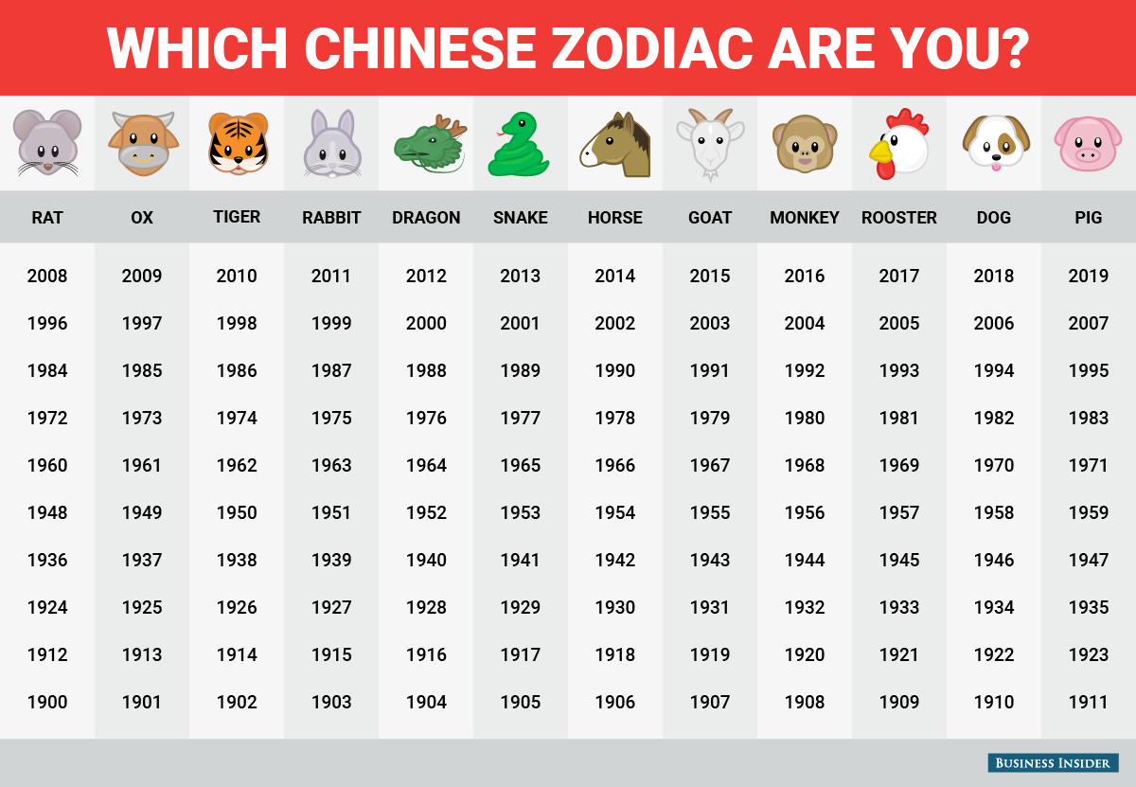
你属什么？
我属______。
鼠 牛 虎 兔 龙 蛇 马 羊 猴 鸡 狗 猪

