Slide 1

Dì kè: kàn bìng
第十五课：看病 Lesson Fifteen: Seeing A Doctor

Slide 2
Duì huà yī Wǒ de dù zi tòng sǐ le
对话一：我的肚子痛死了！My Stomachache Is Killing Me!

Slide 3
Duì huà èr guò miň
对话二：过敏 Allergies

Slide 4
第十五课 学习目标 (Lesson 15 Learning objectives)
    In this lesson, you will learn to use Chinese to
  Talk about basic symptoms of a cold;
  Describe common symptoms of allergies;
  Understand and repeat instructions on when and how often to take medications;
  Talk about why you do or don’t want to see the doctor;
  Urge others to see a doctor when they are not feeling well.

Slide 5
Dì kè: kàn bìng
第十五课：看病 Lesson Fifteen: Seeing A Doctor

Slide 6
Duì huà yī Wǒ de dù zi tòng sǐ le
对话一：我的肚子痛死了！My Stomachache Is Killing Me!

Slide 7
Duì huà èr guò miň
对话二：过敏 Allergies

Slide 8
第十五课 学习目标 (Lesson 15 Learning objectives)
    In this lesson, you will learn to use Chinese to
  Talk about basic symptoms of a cold;
  Describe common symptoms of allergies;
  Understand and repeat instructions on when and how often to take medications;
  Talk about why you do or don’t want to see the doctor;
  Urge others to see a doctor when they are not feeling well.

Slide 9
第十五课 文法重点 (Lesson 15 Grammar Points)
Forms & Accuracy:
死 (sǐ) indicating an Extreme Degree
Times of Actions: 吃了三次药
起来 (qǐ lái) indicating the Beginning of an Action
把 (bǎ) Construction (I)
The measure words for times of actions: 次cì and 遍 biàn.
The Preposition 对(duì)
越来越…(yuè lái yuè)
再说 (zài shuō)

Slide 10
第十五课 对话二
Shēng cí
生词
vocabulary

Slide 11
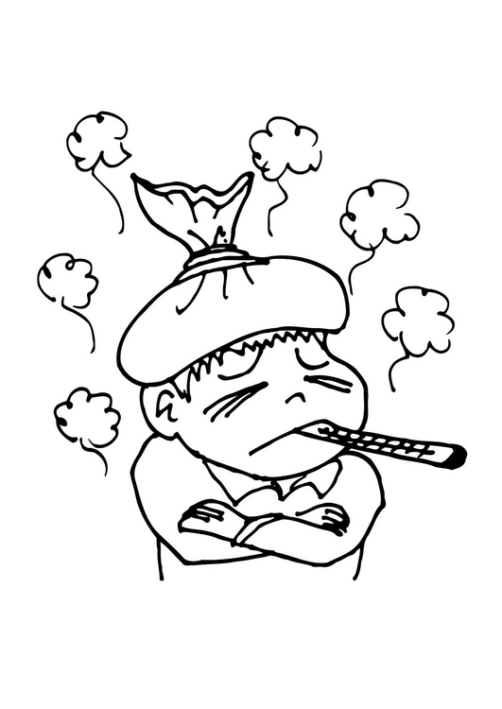
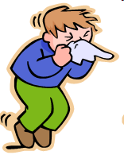


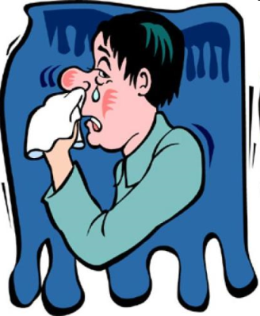
感冒 gǎnmào (to have a cold) verb
我感冒了！
发烧
fāshāo
打噴嚏
dǎ pēn tì
咳嗽 ké sòu
流鼻水
liú bí shuǐ

Slide 12
感冒
  gǎnmào
  to have a cold
v

Slide 13
过敏
  guòmǐn
  to be allergic to
v

Slide 14
痒
  yǎng
  Itchy
adj

Slide 15
懒
  lǎn
  Lazy
adj

Slide 16
乱
  Luàn
  randomly; arbitrarily; messily;
  messy
Adv/Adj

Slide 17
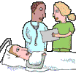
生病
  shēng bìng
  to get sick
vo

Slide 18
身体
  shēntǐ
  body; health
n

Slide 19
休息
  xiūxi
  to take a break; to rest
v

Slide 20
健康
  jiànkāng
  healthy; health
adj/n

Slide 21
保险
  bǎoxiǎn
  Insurance
n

Slide 22
药店
  yàodiàn
  Pharmacy
n

Slide 23

赶快
  gǎnkuài
  right away; quickly;
  in a hurry
adv

Slide 24
要不然
  yàobùrán
  Otherwise
conj

Slide 25
越来越…
  yuè lái yuè
  more and more
adv

Slide 26
上次
  shàng cì
  last time
  adv

Slide 27
感冒 gǎnmào (to catch a cold/flu) verb; noun
你常感冒吗？
感冒的时候怎么不舒服？
你感冒的时候去看医生/吃药吗？
Other combinations:
感： 感谢、感觉、感想、感恩节、重感冒

Slide 28
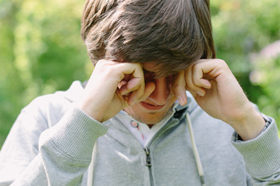
痒 yǎng (itchy) adjective
Q: _____________?
A:我的眼睛很痒？
看到同学打球，他也手痒。
痒：眼睛痒、鼻子痒、七年之痒

Slide 29
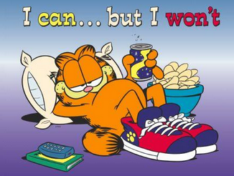
懒 lǎn (lazy) adjective
Q:_________________?
A:因为他很懒。
懒: 懒人、好吃懒做

Slide 30
乱 luàn (randomly, arbitrarily; messily / messy) adv; adj
她的房间很乱。
Her room is very messy.
不能自己乱吃/买药。
Don’t randomly take/buy medicine.
That means to take/buy medicine without doctor’s prescription.

Slide 31
乱 luàn (randomly, arbitrarily; messily / messy) adv; adj
我女儿很懒,都不整理她的房间,所以她的房间很___。
My daughter is very lazy. She does not tidy her room . Her room is very messy.
Don’t randomly take/buy medicine.[That means to take/buy medicine without doctor’s prescription].

Slide 32
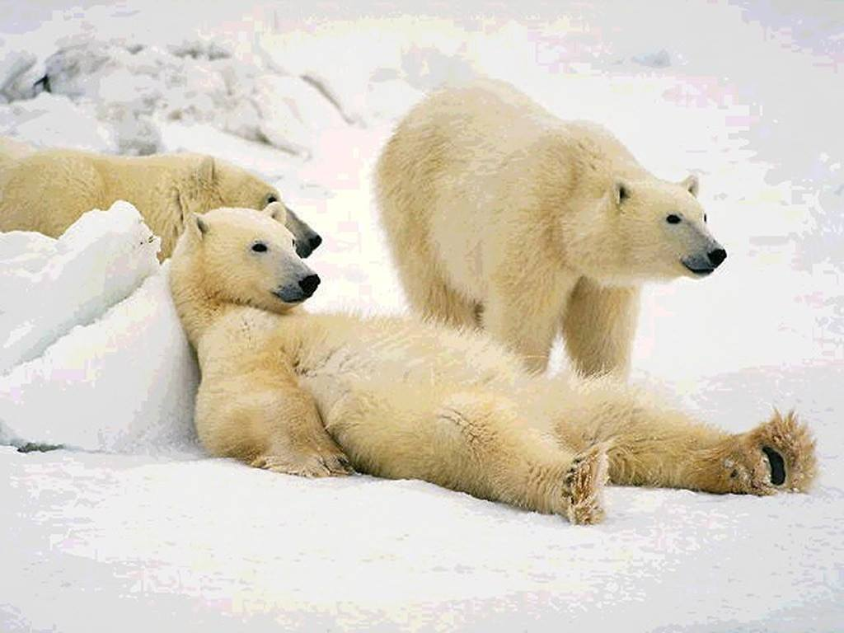
休息 xiūxi (take a break; rest) verb; noun
你中午休息吗?
你晚上什么时候休息?
周末你常在家休息还是出去玩儿?
休息:休息室
休:午休、休假、休学
息:作息时间

Slide 33
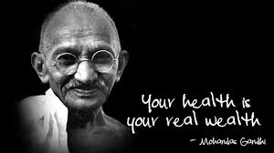
身体 shēntǐ (body; health) noun
我爷爷身体不好。（我爷爷不健康）
My granpa is not in good health.
你爸妈最近身体好吗？
你的身体怎么样？
我的身体很好。
身：健身房、半身、上身、下身、身上、人身
体：人体、体重、气体、体检

Slide 34
健康 jiànkāng (healthy; health) adjective; noun
你现在看起来很健康。You look very healthy now.
为了你的健康，你每天得早点睡觉。
For your health, you have to go to bed earlier.
Q: _______?
A: 我的身体很健康。

Slide 35
保险 bǎoxiǎn (insurance) noun
险－脸－检
险：危险 wēixiǎn (danger)
保险：健康保险、汽车保险、房屋保险
Q: 保险越来越贵，还是越来越便宜？
Q: 你有保险吗? 健康保险还是汽车保险？

Slide 36

药店/局 yào diàn/jú (pharmacy) noun

Slide 37
赶快 gǎnkuài (quickly, in a hurry, hurry up) adverb
赶： 赶飞机 (catch a flight)、赶功课、赶时间
你赶时间吗？
Nǐ gǎn shíjiān ma
Are you in a hurry?
快： 快乐
  你喜欢开快车吗？
  中国新年快到了

Slide 38
赶快 gǎnkuài (quickly, in a hurry, hurry up) adverb
赶快! 要不然看不到电影了。
Gǎnkuài! Yào bùrán kàn bù dào diànyǐngle.
Hurry up! Otherwise (we will) miss the moive!
生病的时候得赶快_____________。
Shēngbìng de shíhòu dé gǎnkuài
When you are ill, you have to hurry up….
明天考试，你得赶快______。
Míngtiān kǎoshì, nǐ dé gǎnkuài
There is a test tomorrow, you have to hurry up …..

Slide 39
上次/下次 shàngcì/xiàcì (last/next time) adverb
Q: 你上次考试考得怎么样?
How did you do in the exam last time?
A: 我上次考试考得不错。
I did well on the last exam.
请你下次来看我的时候,把书带给我.
Please bring your book to me next time you come to see me.
Q:我跟你说几次了? 你为什么还问我。
How many times did I tell you ?Why do you still ask me?
A:你只跟我说了两次.
You only told me two times.

Slide 40
上次/下次 shàngcì/xiàcì (last/next time) adverb
你下次考试记得要带索引卡。
Nǐ xià cì kǎoshì jìdé yào dài suǒyǐnkǎ
Remember to bring index cards next time when you have a quiz.
下次逛街记得要带钱。
Xià cì guàngjiē jìdé yào dài qián
Remember to bring money when you go shopping next time.

Slide 41
第十五课 对话二
Yǔ fǎ
语法
grammar

Slide 42
对 duì (to; with; for) preposition
The preposition 对 (duì) introduces the person or thing that receives a certain effect from someone or something else.
Its English translation varies depending on the context.

Slide 43
对 duì (to; with; for) preposition
我对花生过敏。
Wǒ duì huāshēng guòmǐn.
I am allergic to peanuts.

Slide 44

对 duì (to; with; for) preposition
Q: 你对什么过敏？ What are you allergic to？
A: 我对___过敏。(花、味精、花生、花粉fěn、灰尘）
我对什么东西都不会过敏。
I am not allergic to anything.
过：过冷、过热、过多、过少、过高、

Slide 45
对 duì (to; with; for) preposition
______对_______ + (没)有用
(不)过敏
(没)有帮助

Slide 46
对… 感兴趣 xìngqù interested in…
对… 很感兴趣 xìngqù very interested in…
对… 不感兴趣 xìngqù not interested in…
对 duì (to; with; for) preposition
Q：你对什么感兴趣? What are you interested in?
A：我对_______很感兴趣。I am interested in Chinese/music/dancing.
中文/音乐/跳舞/摄影shèyǐng

Slide 47

对 duì (to; with; for) preposition
这种药对感冒很有用。
Zhè zhǒng yào duì gǎnmào hěn yǒu yòng.
This medicine is very effective for colds.

Slide 48

对 duì (to; with; for) preposition
她的电脑对她练习发音很有用。
Tā de diànnǎo duì tā liànxí fāyīn hěn yǒu yòng.
Her computer is very useful for her pronunciation practice.

Slide 49
对 duì (to; with; for) preposition
你一定对什么东西过敏了。
Nǐ yídìng duì shénme dōngxi guòmǐn le.
You must be allergic to something.

Slide 50
要不然
  yàobùrán
  Otherwise
conj

Slide 51
要不然 yàobùrán (otherwise) conjunction
天气冷，你得穿暖和点，要不然容易_____。
Tiānqì lěng, nǐ dé chuān nuǎnhuo diǎn, yào bùrán róngyì
The weather is cold, you have to wear warmth, otherwise it is easy to ____.

Slide 52
要不然 yàobùrán (otherwise) conjunction
You have to ______________, otherwise _____________.
你得多吃蔬菜水果,要不然你会不健康。
Nǐ dé duō chī shūcài shuǐguǒ, yào bùrán nǐ huì bùjiànkāng.
You have to eat more vegetables and fruits, otherwise you won’t be healthy.
你得多做运动,要不然你会越来越胖。
Nǐ dé duō zuò yùndòng, yào bùrán nǐ huì yuè lái yuè pàng.
You have to exercise more, otherwise you will become more overweight/fatter.
你得多吃点,要不然你会越来越瘦。
Nǐ dé duō chī diǎn, yào bùrán nǐ huì yuè lái yuè shòu
You have to eat more, otherwise you will become skinnier (瘦 shòu）

Slide 53
要不然 yàobùrán (otherwise) conjunction
Nǐ dé yào bùrán
你得... 要不然...
吃药 感冒不会好 1st piece of advice
注意身体 病不会好 2nd piece of advice
多休息 会生病 3rd piece of advice

Slide 54
越来越…
  yuè lái yuè
  more and more
adv

Slide 55
越来越… yuè lái yuè... (more and more) adverb
The structure 越来越… (yuè lái yuè) denotes
a progressive change over time.

Slide 56
越来越… yuè lái yuè... (more and more) adverb
You haven’t seen this person for a long while. What would you say to him/her using this phrase.
你看起来越来越 ___________了。
Nǐ kàn qǐlái yuè lái yuè le
You look more and more ______________.
                漂亮、高、可爱、聪明、年轻
                piàoliang gāo kě’ài cōngmíng niánqīng
                beautiful, tall, cute, smart, young

Slide 57

越来越… yuè lái yuè... (more and more) adverb
李友的中文越来越好。
Lǐ Yǒu de Zhōngwén yuè lái yuè hǎo.
Li You’s Chinese is getting better and better.

Slide 58

越来越… yuè lái yuè... (more and more) adverb
天气越来越暖和了。
Tiānqì yuè lái yuè nuǎnhuo le.
The weather is becoming warmer and warmer.

Slide 59

越来越… yuè lái yuè... (more and more) adverb
表姐考试考得越来越糟糕。
Biǎojiě kǎo shì kǎo de yuè lái yuè zāogāo.
My cousin is doing worse and worse on her exams.

Slide 60
越来越… yuè lái yuè... (more and more) adverb
Q：你学中文学得怎么样？
    Nǐ xué zhōng wénxué dé zěnme yang
    How is your Chinese learning?
Q：最近Issaquah天气怎么样？
    Zuìjìn Issaquah tiānqì zěnme yàng?
    How’s it in Issaquah recently?
Q：今年学校餐厅的菜怎么样？
    Jīnnián xuéxiào cāntīng de cài zěnme yang
    How’s the food of the school cafeteria this year?
Q：这个学期的课怎么样？
    Zhège xuéqí de kè zěnme yang
    How are your classes this semester?

Slide 61
再说
  zàishuō
  Moreover
conj

Slide 62
再说 zàishuō (moreover) conjunction
The expression 再说 (zàishuō) introduces an additional reason for an action that has been taken or decision that has been made.
It is different from 再 + 说 (zài + shuō, to say again).

Slide 63
再说 zàishuō (moreover) conjunction
Q:你为什么不去纽约？
Nǐ wèishénme bú qù Niǔyuē?
Why aren’t you going to New York?
A:我没有时间;再说，也没有钱。
Wǒ méiyǒu shíjiān; zàishuō, yě méiyǒu qián.
I don’t have the time; besides, I don’t have the money.

Slide 64

再说 zàishuō (moreover) conjunction
Q:你为什么不喜欢今天晚上的舞会？
Nǐ wèishéme bù xǐhuān jīntiān wǎnshàng de wǔhuì
Why don't you like the dance party tonight?
A:我觉得音乐不好；再说，人也太少。
Wǒ juédé yīnyuè bù hǎo; zàishuō, rén yě tài shǎo
I don’t think the music is good; let’s say there are too few people.

Slide 65
再说 zàishuō (moreover) conjunction
Reasons and Excuses:
Q1: 你为什么不去看医生? Why don’t you go to see a doctor?
A1: 我没钱;再说, _____。
Q2: 昨晚你为什么没有打电话给我? Why didn’t you call me last night?
A2: ______;再说, _____。
Q3: 你为什么不喜欢他? Why don’t you like him?
A3: ______;再说, _____。
Do more practice on p. 157-158

Slide 66
再说 (zàishuō) = 而且 (érqiě)
再说 zàishuō (moreover) conjunction
conveys the idea of “furthermore, additionally”.

Slide 67

而且 (érqiě) can be replaced with 再说 (zàishuō)
Q:你为什么不去纽约？
Nǐ wèishénme bú qù Niǔyuē?
Why aren’t you going to New York?
A:我没有时间；而且，也没有钱。
Wǒ méiyǒu shíjiān; érqiě, yě méiyǒu qián.
I don’t have the time. Besides, I don’t have the money.

Slide 68

看医生 (kàn yīshēng) v.s. 看病 (kàn bìng)
The two phrases 看医生 (kàn yīshēng) and 看病 (kàn bìng) are interchangeable
in northern China 看病 (kàn bìng) is much more common.

