Slide 1

Dì kè: lǚ xíng
第十九课：旅行 Lesson Nineteen: Travel

Slide 2
Duì huà yī Dào běijīng lǚ yóu
对话一：到北京旅游 Traveling to Beijing

Slide 3
Duì huà èr Jì huà xíngchéng
对话二：计划行程 Planning an Itinerary

Slide 4
第十九课 学习目标 (Lesson 19 Learning objectives)
    In this lesson, you will learn to use Chinese to
  Talk about your plans for summer vacation;
  Describe what kind of city Beijing is;
  Describe your travel itinerary;
  Ask for discounts, compare airfares and routes, and book an airplane ticket;
  Ask about seat assignments and request meal accommodations based on your dietary restrictions or preferences.

Slide 5
第十九课 学习目标 (Lesson 19 Learning objectives)
Forms & Accuracy:
不得了 extremely
Question Pronouns as Indefinite References (Whoever, Whatever, etc.) : 谁想去，谁就去
Numbers over One Thousand: 千、万、亿、十亿
Comparative Sentences with比 (II)

Slide 6
第十九课 对话一
Shēng cí
生词
vocabulary

Slide 7
父母
fùmǔ
parents; father and mother
n

Slide 8
马上
mǎshàng
immediately; right away
adv

Slide 9
放
fàng
to let go; to set free
v

Slide 10

假
jià
vacation; holiday
n

Slide 11

放假
fàng jià
go on vacation; have time off
vo

Slide 12

暑假
shǔjià
summer vacation
n

Slide 13
公司
gōngsī
company
n

Slide 14

实习
shíxí
to intern
v

Slide 15

打工
dǎ gōng
to work at a temporary job (often part time)
vo

Slide 16

计划
jìhuà
plan; to plan
n/v

Slide 17

打算
dǎsuàn
to plan; plan
v/n

Slide 18
订
dìng
to reserve; to book (a ticket, a hotel room, etc.)
v

Slide 19
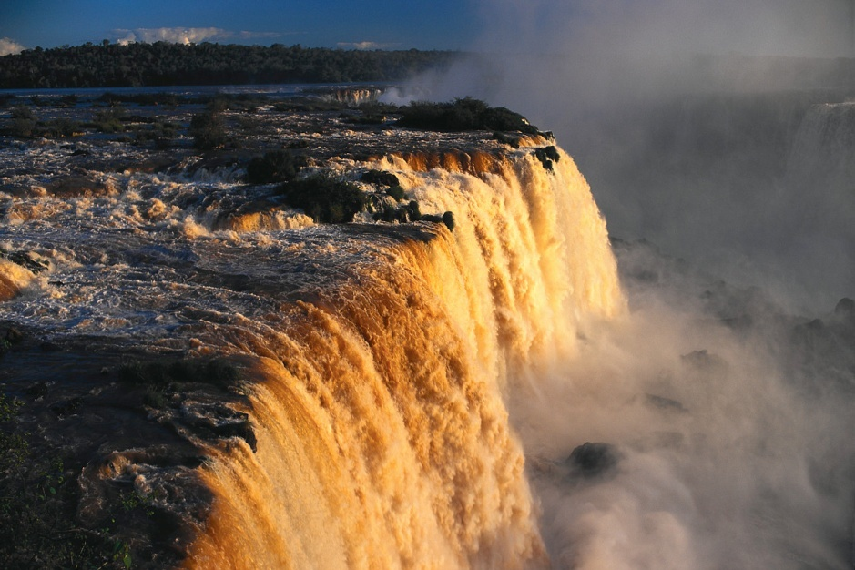
有名
yǒumíng
famous; well-known
adj

Slide 20

政治
zhèngzhì
politics
n

Slide 21
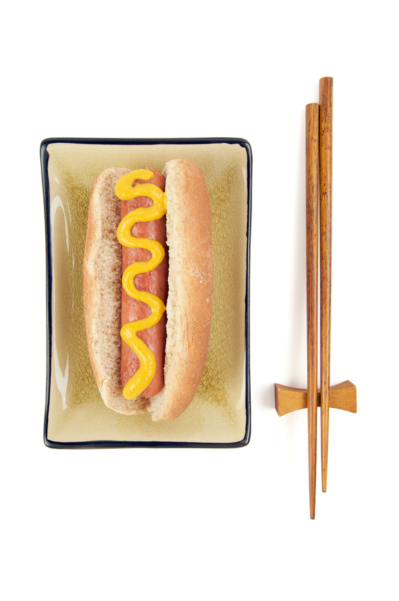
文化
wénhuà
culture
n

Slide 22
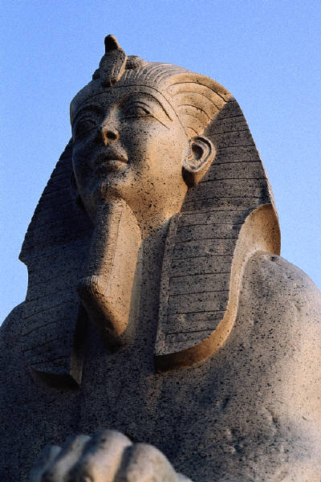
名胜古迹
míngshèng gǔjì
famous scenic spots and historic sites

Slide 23
导游
dǎoyóu
tour guide
n

Slide 24

护照
hùzhào
passport
n

Slide 25
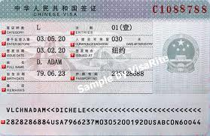
签证
qiānzhèng
visa
n

Slide 26
旅行社
lǚxíngshè
travel agency
n

Slide 27
首都
shǒudū
capital city
n

Slide 28
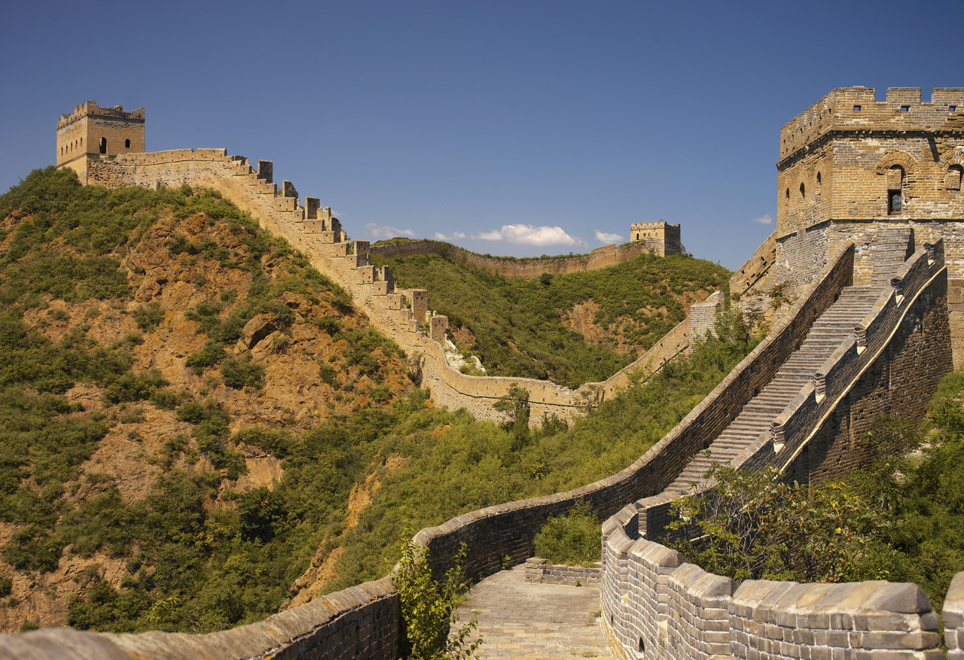
长城
Chángchéng
the Great Wall

Slide 29
香港
Xiānggǎng
Hong Kong

Slide 30
台北
Táiběi
Taipei

Slide 31
放假 fàng jià (go on vacation; have time off) vo
你什么时候放假？
Nǐ shénme shíhòu fàngjià
When are you going to have time off?
我们什么时候放暑假？
Wǒmen shénme shíhòu fàng shǔjià
When are we going to have summer vacation?
Notes:
Textbook: pp 263-265

Slide 32
马上 mǎshàng (immediately; right away) adv
我现在马上就来。
I will come immediately.
你可以马上打电话给他吗？
Can you call here right away?
Notes:
Textbook: pp 263-265

Slide 33
父母 fùmǔ (parents; father and mother) n
我的______都在学校工作。
Wǒ de dōu zài xuéxiào gōngzuò
My parents both work at schools.
这个暑假我要回纽约看我_____。
Zhège shǔjià wǒ yào huí niǔyuē kàn wǒ de
This summer I am going back to New York to see my parents.
Notes:
Textbook: pp 263-265

Slide 34
计划 jìhuà (plan) noun; (to plan) verb
Q: 你这个寒假有什么计划/打算？ (noun)
Nǐ zhège hánjià yǒu shé me jìhuà/dǎsuàn
What are your plans for this winter vacation?
(verb)
A：我计划去北京旅游。
Wǒ jìhuà qù běijīng lǚyóu
I plan to travel to Beijing.

Slide 35
计划 jìhuà (plan) noun; (to plan) verb
Q:你这个暑假你有什么计划？
Nǐ zhège shǔjià nǐ yǒu shé me jìhuà
Do you have any plan for this summer
Q:这个暑假你计划做什么？
What do you plan to do this summer?
A：我打算去公司实习。
Wǒ dǎsuàn qù gōngsī shíxí
I plan to do an intern at a company.

Slide 36
打算 dǎsuàn (plan) noun; (to plan) verb
Q:今天晚上打算跟你朋友去哪儿看电影？
Jīntiān wǎnshàng dǎsuàn gēn nǐ péngyǒu qù nǎ'er kàn diànyǐng
Where do you plan to see a movie with your friends tonight?
A:我们打算在家看电影。
Wǒmen dǎsuàn zàijiā kàn diànyǐng
We plan to/are going to watch a movie at home.

Slide 37
打算 dǎsuàn (plan) noun; (to plan) verb
Q:你星期五晚上打算做什么？
Nǐ wǎnshàng dǎsuàn zuò shénme
What do you plan to do Friday night?
A:我打算好好准备一下明天的考试。
Wǒ dǎsuàn hǎohǎo zhǔnbèi yīxià míngtiān de kǎoshì
I plan to prepare for tomorrow's exam.

Slide 38
打算 dǎsuàn / 计划 jìhuà (to plan)
Q:马上就要放假了，你有什么计划？
mǎshàng jiù yào fàng jià le, nǐ yǒu shénme jìhuà?
It’ll be break soon. What are your plans?
A:我暑假打算回北京去看父母。
Wǒ shǔjià dǎsuàn huí Běijīng qù kàn fùmǔ.
I plan to go back to Beijing to see my parents.

Slide 39
实习 shíxí (to intern) verb
我想在您的公司实习。
I would like to intern at your company.
Notes:
Textbook: pp 263-265

Slide 40
实习 shíxí (to intern) verb
Q: 你这个暑假有什么计划/打算？
Nǐ zhège shǔjià yǒu shé me jìhuà/dǎsuàn
What are your plans for this summer vacation?
A：我打算去公司实习。
Wǒ dǎsuàn qù gōngsī shíxí
I plan to do an intern at a company.

Slide 41
实习 shíxí (to intern) verb
Q: 你做过实习吗？在哪儿实习？
Nǐ zuòguò shíxí ma? Zài nǎ'er shíxí
Have you ever interned? Where did you intern?
A：我在Amazon做过实习。
I have interned at Amazon .
A：我没有做过实习。

Slide 42
打工 dǎ gōng (to work at a temporary job; often part time) vo
Q: 你这个暑假有什么计划/打算？
Nǐ zhège shǔjià yǒu shé me jìhuà/dǎsuàn
What are your plans for this summer vacation?
A: 我打算去一家中国饭馆打工。
Wǒ dǎsuàn qù yījiā zhōngguó fànguǎn dǎgōng
I plan to work at a temporary job at a Chinese restaurant.
Notes:
Textbook: pp 263-265

Slide 43
打工 dǎ gōng (to work at a temporary job; often part time) vo
Nǐ dǎgōng guò ma? Zài nǎ'er dǎgōng?
Q: 你打工过吗？在哪儿打工？
Wǒ dǎgōng guò. Zài cāntīng dǎgōng.
A：我打工过。在餐厅打工。
Wǒ méiyǒu dǎgōng guò.
A：我没有打工过。

Slide 44

the verb 办 (bàn)
To apply for a certificate or official documentation, one usually uses the verb 办 (bàn), especially in spoken Chinese.
办签证
bàn qiānzhèng
to apply for a visa
办护照
bàn hùzhào
to apply for a passport

Slide 45


the verb 办 (bàn)
To apply for a certificate or official documentation, one usually uses the verb 办 (bàn), especially in spoken Chinese.
办学生证
bàn xuéshēngzhèng
to apply for a student ID
办结婚证
bàn jiéhūnzhèng
to apply for a marriage license

Slide 46

the verb 办 (bàn)
To apply for a certificate or official documentation, one usually uses the verb 办 (bàn), especially in spoken Chinese.
办手续
bàn shǒuxù
to do the paperwork

Slide 47
护照 hùzhào (passport) noun
Q:你有护照吗？
Nǐ yǒu hùzhào ma
Do you have a passport?
Q:你有美国护照吗？
Nǐ yǒu měiguó hùzhào ma
Do you have a US passport?
Notes:
Textbook: pp 263-265

Slide 48
签证 qiānzhèng (visa) noun
Q:你有签证吗？
Nǐ yǒu qiānzhèng ma
Do you have a visa??
Q:你有哪个国家的签证？
Nǐ yǒu nǎge guójiā de qiānzhèng
Q:你办过哪个国家的签证？
Nǐ bànguò nǎge guójiā de qiānzhèng
A:我办过中国的签证。
Notes:
Textbook: pp 263-265

Slide 49
首都 shǒudū (capital city) noun
Q:美国首都在哪儿？
Měiguó shǒudū zài nǎ'er
Where is the capital of the United States?
A:美国首都在华盛顿哥倫比亞特區
Měiguó shǒudū zài Huáshèngdùn gēlúnbǐyǎ tèqū
The capital of USA is Washington D.C.
Notes:
Textbook: pp 263-265

Slide 50
首都 shǒudū (capital city) noun
英国—伦敦 London
yīngguó lúndūn
法国—巴黎 Paris
fàguó bālí
德国—柏林 Berlin
déguó bólín
意大利—罗马 Rome
yìdàlì luómǎ
澳洲—坎贝拉 Canberra
àozhōu kǎn bèi lā
中国—北京
zhōngguó běijīng
日本—东京 Tokyo
rìběn dōngjīng
韩国—首尔；汉城 Seoul
hánguó shǒu'ěr; hànchéng
臺灣—台北 Taipei
táiwān táiběi
Notes:
Textbook: pp 263-265

Slide 51
旅游 lǚyóu (to travel; trip/travel) verb; noun
Q：你最想去旅游的三个国家/城市是什么？
Nǐ zuì xiǎng qù lǚyóu de sān gè guójiā/ chéngshì shì shénme
The three countries/cities that you want to travel the most?
A：我最想去旅游的三个国家/城市是__,__和__。
Wǒ zuì xiǎng qù lǚyóu de sān gè guójiā/ chéngshì shì
The three countries/cities that you want to travel are __, __ and_.
Notes:
Textbook: pp 263-265

Slide 52
名胜古迹
míngshèng gǔjì
famous scenic spots and historic sites

Slide 53
名胜古迹 míngshèng gǔjì (famous scenic spots and historic sites)
Q：中国有什么名胜古迹？
Zhōngguó yǒu shéme míngshèng gǔjī
Q：中国有很多名胜古迹吗？
Zhōngguó yǒu hěnduō míngshèng gǔjī ma
Q：你去过哪些名胜古迹？
Nǐ qùguò nǎxiē míngshèng gǔjī
A：我去过…
中国—北京
zhōngguó běijīng
日本—东京
rìběn dōngjīng
韩国—首尔；汉城
hánguó shǒu'ěr; hànchéng
臺灣—台北
táiwān táiběi
Notes:
Textbook: pp 263-265

Slide 54
名胜古迹 míngshèng gǔjì (famous scenic spots and historic sites)
Q:这个名胜古迹在哪里？
Zhège míngshèng gǔjī zài nǎlǐ
Where is this famous historic site?
A:这个名胜古迹在中国北京。
Zhège míngshèng gǔjī zài zhōngguó běijīng
This famous historic site is in Beijing, China.
Notes:
Textbook: pp 263-265

Slide 55
名胜古迹 míngshèng gǔjì (famous scenic spots and historic sites)
Q：这是哪里的名胜古迹？
Zhè shì nǎlǐ de míngshèng gǔjī
Where is this famous historic site?
A：这是（在）中国北京的名胜古迹。
Zhè shì ( zài) zhōngguó běijīng de míngshèng gǔjī
This famous historic site is in Beijing, China.
Q：这个名胜古迹在哪里？
Zhège míngshèng gǔjī zài nǎlǐ
A：这个名胜古迹在中国北京。
Zhège míngshèng gǔjī zài zhōngguó běijīng
Notes:
Textbook: pp 263-265

Slide 56
名胜古迹 míngshèng gǔjì (famous scenic spots and historic sites)
Q：你最想去旅游的三个国家/城市？
Nǐ zuì xiǎng qù lǚyóu de sān gè guójiā/ chéngshì
The three countries/cities that you want to travel the most?
Q: 你最想看的三个名胜古迹？
Nǐ zuì xiǎng kàn de sān gè míngshèng gǔjī
The three historical sites you want to see the most?
A：我最想去旅游的三个国家是__, __ 和__。
Zhè shì zài zhōngguó běijīng de míngshèng gǔjī
This famous historic site is in Beijing, China.
Notes:
Textbook: pp 263-265

Slide 57
找图片 （Find the pictures)
Q:你最想看的三个名胜古迹是什么？
Nǐ zuì xiǎng kàn de sān gè míngshèng gǔjī shì shénme
The three historical sites you want to see the most?
A:我最想看的三个名胜古迹是__, __ 和__。
Wǒ zuì xiǎng kàn de sān gè míngshèng gǔjī shì
The three famous historic sites I want to see the most are ____, ____ and ___.
Notes:
Textbook: pp 263-265

Slide 58
第十九课 对话一
Yǔ fǎ
语法
grammar

Slide 59

不得了 bù déliǎo (extremely)
The expression indicates a high degree, in the speaker’s judgment, of the attribute signified by the adjective preceding it.
那个地方夏天热得不得了。
Nà ge dìfang xiàtiān rè de bù déliǎo.
Summer is unbearably hot in that place.
坎贝拉夏天热得不得了。
xiàtiān rè de bù déliǎo.
The summer is unbearably hot in Canberra.
.
Notes:
Textbook: pp 263-265 Do Language Practice E p. 264. 不得了

Slide 60
不得了 bù déliǎo (extremely)
The expression indicates a high degree, in the speaker’s judgment, of the attribute signified by the adjective preceding it.
长城上的人多得不得了。
Chángchéng shàng de rén duō de bù dé liǎo
There was an incredible number of people on the Great Wall.
Notes:
Textbook: pp 263-265

Slide 61
Adj 得+不得了/极了/死了 (extremely)
上海夏天天气 __得不得了。
Shànghǎi xiàtiān tiānqì dé bù dé li
北京的名胜古迹___得不得了。
寒假飞机票__得不得了。
那个地方漂亮极了。
Nàgè dìfāng piàoliang jí le
That place is extremely beautiful.
我累死了。
I am tired to death.
Notes:
Textbook: pp 263-265

Slide 62
第十九课 对话二
Shēng cí
生词
vocabulary

Slide 63

单程
Dānchéng
one-way trip
n

Slide 64

往返
Wǎngfǎn
make a round trip;
go there and back
v

Slide 65

航空
hángkōng
aviation
n

Slide 66

航班
Hángbān
scheduled flight
n

Slide 67

直飞
zhí fēi
fly directly

Slide 68

转机
zhuǎn jī
change planes
vo

Slide 69
打折
dǎ zhé
to sell at a discount;
to give a discount
vo

Slide 70

靠
kào
to lean on; to lean against;
to be next to
v

Slide 71

窗戶
chuānghu
window
n

Slide 72
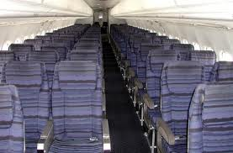
走道
zǒudào
aisle
n

Slide 73
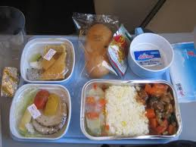
份
Fèn
measure word for meal order, job
m

Slide 74
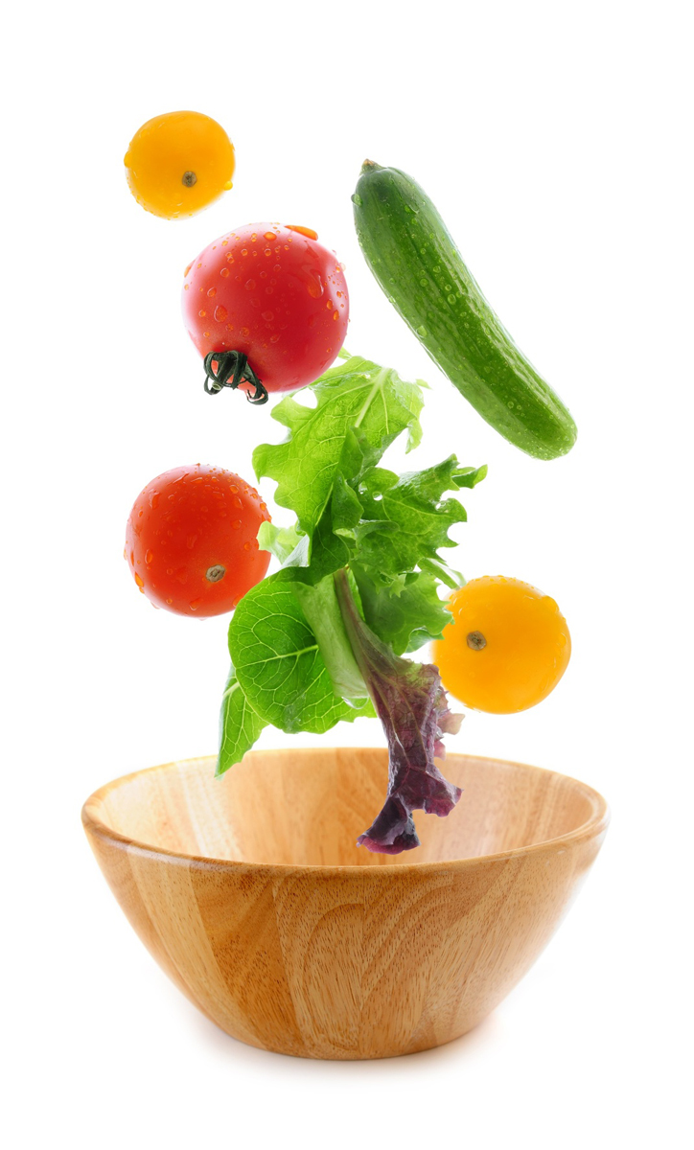
素餐
sùcān
vegetarian meal
n

Slide 75

旅馆
Lǚguǎn
hotel
n

Slide 76
租
zū
to rent
v

Slide 77
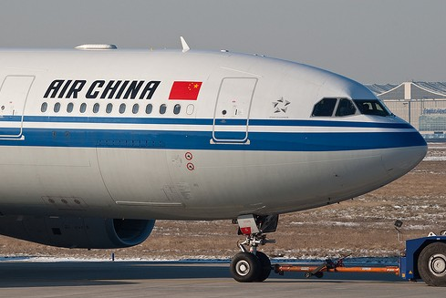
中国国际航空公司
Zhōngguó Guójì Hángkōng Gōngsī
Air China

Slide 78
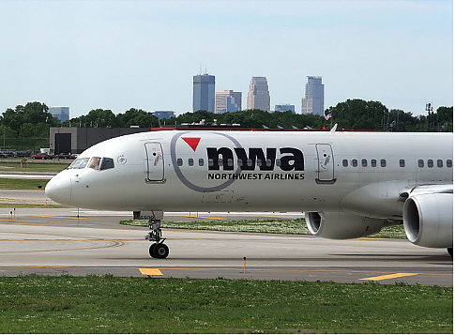
西北航空公司
Xīběi Hángkōng Gōngsī
Northwest Airlines

Slide 79

查
chá
to check; to look into
v

Slide 80

千
qiān
thousand
nu

Slide 81

初
chū
beginning
n

Slide 82
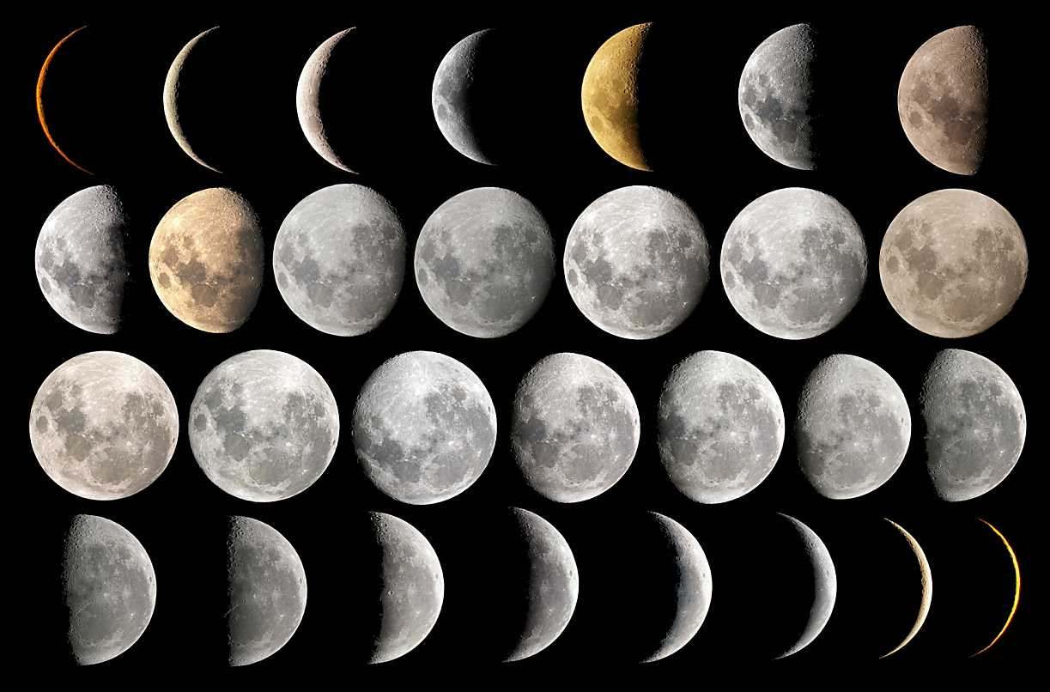
初一、初二、初三… The first day of

Slide 83
初 (chū, beginning); 中 (zhōng, middle); 底 (dǐ, end; bottom)
月初 (yuè chū) refers to the first few days of the month, typically from the 1st to the 5th or 6th.
月中 (yuè zhōng) is for the middle of the month, roughly from the 14th to 16th or 17th.
月底 (yuè dǐ) means the fi nal days of the month, usually from the 27th or 28th.

Slide 84
初 (chū, beginning); 中 (zhōng, middle); 底 (dǐ, end; bottom)
年初 (nián chū, beginning of the year)
年中 (nián zhōng, middle of the year)
年底 (nián dǐ, end of the year)

Slide 85
初 (chū, beginning);
他说话像月亮，
Tā shuōhuà xiàng yuèliàng,
He speaks like the moon,
初一、十五不一样。
chū yī, shíwǔ bù yīyàng.
which varies on the first day and on the fifteenth day .

Slide 86
The approach to describing a discount in Chinese is different from that in English.
In English
the emphasis is on the amount that is given as a discount,
e.g., 10% off, 20% off, etc.
In Chinese, however, the emphasis is on the proportion of the original price that is actually paid.

Slide 87
The approach to describing a discount in Chinese is different from that in English.
In Chinese
九折 (jiǔ zhé) means that the price is 90% of the original price, or 10% off;
七五折 (qī wǔ zhé) means 75% of the original price;
对折 (duì zhé) 50% of the original price.

Slide 88
Count in Chinese up to a thousand
Number | Chinese | Pinyin | English
1 | 一 | yī | one
10 | 十 | shí | ten
100 | 百 | bǎi | hundred
1000 | 千 | qiān | thousand

Slide 89
Numbers over One Thousand
In Chinese the next larger unit after a thousand is not called *十千 (*shí qiān), but 万 (wàn).
The Chinese share the international practice of segmenting a long Arabic number into three-digit sets in writing or in print.
They mentally divide the number into four-digit sets instead when they read it.

Slide 90
Count Starting at the fifth digit from the right is the four-digit set of 万 (wàn), and the next four digit set is that of 亿 (yì).
English | Arabic | Number Mental Division | Chinese | Pinyin
thousand | 1,000 | 1000 | (一）千 | (yì) qiān
ten thousand | 10,000 | 1p0000 | (一）万 | (yí) wàn
hundred thousand | 100,000 | 10p0000 | 十万 | shí wàn
million | 1,000,000 | 100p0000 | (一）百万 | (yì) bǎi wàn
ten million | 10,000,000 | 1000p0000 | (一）千万 | (yì) qiān wàn
hundred million | 100,000,000 | 1p0000p0000 | (一）亿/ (一）万万 | (yí) yì/ (yí) wànwàn
billion | 1,000,000,000 | 10p0000p0000 | 十亿 | shí yì

Slide 91
Count Starting at the fifth digit from the right is the four-digit set of 万 (wàn), and the next four digit set is that of 亿 (yì).
12,345
(1p2345)
一万两千三百四十五
yí wàn liǎng qiān sān bǎi sìshíwǔ
25,000
(2p5000)
两万五千
liǎng wàn wǔ qiān

Slide 92
Count Starting at the fifth digit from the right is the four-digit set of 万 (wàn), and the next four digit set is that of 亿 (yì).
三十四万零八百七十六
sānshísì wàn líng bā bǎi qīshíliù
340,876
(34p0876)
十亿零九十万
shí yì líng jiǔshí wàn
1,000,900,000
(10p0090p0000)

Slide 93
长城
Chángchéng
the Great Wall

Slide 94
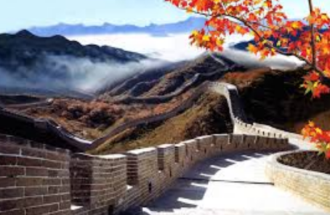
万里长城 wànlǐ chángchéng (Ten Thousand Miles Long Wall)

Slide 95
Question Pronouns as Indefinite References
(Whoever, Whatever, etc.)
A question pronoun repeated in two separate but related clauses of the same sentence forms the equivalent of the “question pronoun + -ever” expression in English.
Its first occurrence refers to an indefinite person, object, time, place, etc. Its second occurrence then refers to that same person, object, time, place, etc.

Slide 96

The two occurrences of the question pronoun play the same grammatical role, both are subjects.
Question Pronouns as Indefinite References
=Whoever, Whatever, etc. in English
谁想去，谁就去。
Shéi xiǎng qù, shéi jiù qù.
Whoever wants to go can go.

Slide 97

The two occurrences of the question pronoun play the same grammatical role, both are subjects.
Question Pronouns as Indefinite References
=Whoever, Whatever, etc. in English
你吃什么，我就吃什么。
Nǐ chī shénme, wǒ jiù chī shénme.
I’ll have whatever you’re having.

Slide 98

Sometimes the two occurrences of the question pronoun perform different grammatical functions. the first is the subject whereas the second is the object.
Question Pronouns as Indefinite References
=Whoever, Whatever, etc. in English
哪双鞋便宜，就买哪双。
Nǎ shuāng xié piányi, jiù mǎi nǎ shuāng.
Buy whichever pair of shoes is the cheapest.

Slide 99

Question Pronouns as Indefinite References
=Whoever, Whatever, etc. in English
Taxi Driver:
您想怎么走？
Nín xiǎng zěnme zǒu?
Which way do you want to take?
Passenger:
怎么近，怎么走。
Zěnme jìn, zěnme zǒu.
I’ll take whichever is the shortest distance.

Slide 100
The adverb 就 (jiù) often precedes the verb in the second clause, but not always.
哪儿安静，我就住哪儿。
Nǎr ānjìng, wǒ jiù zhù nǎr.
I’ll live wherever it’s quiet.

Slide 101

The adverb 就 (jiù) often precedes the verb in the second clause, but not always.
A:他找谁帮他搬家具？
Tā zhǎo shéi bāng tā bān jiājù?
Who is he going to ask to help him move his furniture?
B:谁身体棒，他就找谁。
Shéi shēntǐ bàng, tā jiù zhǎo shéi.
He’ll ask whoever is strong.

Slide 102
Comparative Sentences with 比 (bǐ)
In a sentence where 比 (bǐ) is used, a numeral + measure word combination can be placed after the adjective to indicate the disparity

Slide 103


Comparative Sentences with 比 (bǐ)
A + 比 (bǐ) + B + Adjective + Numeral + Measure Word + Noun
我们班比你们班多四个学生。
Wǒmen bān bǐ nǐmen bān duō sì ge xuésheng.
Our class is larger than yours by four students.

Slide 104
Comparative Sentences with 比 (bǐ)
A + 比 (bǐ) + B + Adjective + Numeral + Measure Word + Noun
这件衬衫比那件衬衫贵二十塊钱。
Zhè jiàn chènshān bǐ nà jiàn chènshān guì èrshí kuài qián.
This shirt is twenty dollars more expensive than that shirt.

Slide 105
Comparative Sentences with 比 (bǐ)
A + 比 (bǐ) + B + Adjective + Numeral + Measure Word + Noun
我的房租比你的便宜五百块。
Wǒ de fángzū bǐ nǐ de piányi wǔ bǎi kuài.
My rent is five hundred dollars cheaper than yours.

