Slide 1
Duì huà Zhǔnbèi zhōngwén kè 对话二：准备中文课 Preparing for a Chinese Class

Slide 2
Dì kè: xué zhōng wén 第七课：学中文 Lesson Seven: Studying Chinese
LEARNING OBJECTIVES:
In this lesson, you will learn to use Chinese to
Comment on one’s performance in an exam;
Comment on one’s character writing;
Talk about one’s experience in learning Chinese vocabulary and grammar;
Talk about one’s study habits;
Remark on typical scenes from one’s language class.

Slide 3
Dì kè: xué zhōng wén 第七课：学中文 Lesson Seven: Studying Chinese
Forms & Accuracy:
1. Descriptive Complements (I): 得 Ex 写得很好
2. The Adverbs 太 (tài) and 真 (zhēn)
3. The Adverb 就 (jiù) (I)
4. Double Objects
5. Ordinal Numbers
6. 有(一)点儿 (yǒu{yì}diǎnr)
7. 怎么 (zěnme) in Questions
8. The 的 (de) Structure (I) Ex 男的、容易的= a noun
9. The Use of Nouns and Pronouns in Continuous Discourse

Slide 4
第七课 对话二
Shēng cí
生词
vocabulary

Slide 5
学习中文 xuéxí zhōngwén (study Chinese)
学习 study
预习 preview
练习 practice
复习 review
准备 prepare
念 read
写 write
教 teach
懂 understand
难 difficult
课文 text
生词 new word(s)
语法 grammar
录音 recording
功课 homework
作业
笔、纸 pen、paper

Slide 6
功课 gōng kè (homework) noun
Homework 功课＝作业 (zuòyè)
Study; schoolwork 功课
Ex1: 你昨天做中文功课了吗？
Nǐ zuótiān zuò zhōngwén gōngkè le ma
Did you do your Chinese homework last night?
Ex2: 他功课很好＝他学习很好
Tā gōngkè hěn hǎo Tā gōngkè hěn hǎo
His does well with academic work=He studies well.

Slide 7
录音 lù yī (audio; sound recording) noun/verb
Nǐ chángcháng tīng zhōngwén lùyīn ma
Q:你常常听中文录音吗？
Wǒ chángcháng tīng zhōngwén lùyīn
A:我常常听中文录音。
I often listen to Chinese audios.
Nǐ bāng wǒ lùyīn hǎo ma
Q:你帮我录音，好吗？Can you record me, OK?
A:好，我帮你录音。

Slide 8
反义词 fǎnyì cí (antonym)
快 kuài、 慢 màn fast slowly
难 nán、 容易 róng yì hard easy
早 zǎo、 晚 wǎn early late
多 duō、 少 shǎo many few
大 dà、 小 xiǎo big small
对 duì、 错 cuò right wrong

Slide 9
kāi shǐ

Slide 10
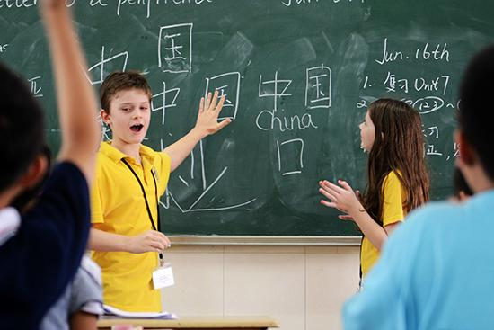
开始 kāishǐ (to start) verb
Wǒmen kāishǐ shàngkè
我们开始上课！
Let’s start our class!
Wǒmen jǐ diǎn kāishǐ shàng zhōngwén kè
Q:我们几点开始上中文课？
What time do we start Chinese Class?
Wǒmen jiǔ diǎn wǔ fēn kāishǐ shàng zhōngwén kè
A:我们九点五分开始上中文课。
We start Chinese class at 9:05.

Slide 11
平常 píngcháng (usually) adverb
Frequency Adverbs:
Píngcháng chángcháng yǒu de shíhòu bù cháng
平常 、常常、有的时候、不常
usually often sometimes seldom

Slide 12
平常 píngcháng (usually) adverb
Nǐ píngcháng jǐ diǎn lái xuéxiào
Q:你平常几点来学校？
When do you usually come to school?
Wǒ píngcháng qī diǎn bàn lái xuéxiào
A:我平常七点半来学校。
I usually come to school at 7:30 am.
Q:你平常几点睡觉？When do you usually go to sleep?

Slide 13
平常 píngcháng (usually) adverb
Nǐ píngcháng jǐ diǎn lái xuéxiào
Q:你平常几点来学校？When do you usually come to school?
Wǒ píngcháng qī diǎn lái xuéxiào Wǒ láidé hěn zǎo
A:我平常七点来学校。我来得很早。
I usually come to school at 7 am. I come very early.
Wǒ píngcháng bā diǎn lái xuéxiào Wǒ lái de hěn wǎn
我平常八点来学校。我来得很晚。
I came to school at 8 am today. I come very late.

Slide 14
大家 dà jiā (everybody) pronoun
大家好！ Greetings to all; Hello, everyone!
Dàjiā yì qǐ niàn
大家一起念。 Everybody reads together.

Slide 15
第十四课 对话二
Yǔ fǎ
语法
grammar

Slide 16
的 de particle
Adj+的 + Noun
他有一个漂亮的女朋友。
我认识一个男的同学。他很高，很帅。
Wǒ rèn shí yīgè nán de tóngxué Tā hěn gāo, hěn shuài
I know a male student. He is very tall and handsome.
中文课有五个学生: 两个男的，三个女的。
The Chinese class has five students:
Two male (students) and three female (students).
Adjective +的= Possessive pronoun

Slide 17
的 de particle
Zhōngwén kè yǒu jǐ ge nán de tóngxué
中文课有几个男的同学？
How many male students are there in the Chinese class?
Zhōngwén kè yǒu jǐ ge nǚ de tóngxué
中文课有几个女的同学？

Slide 18
怎么 zěnme (how to …/ how come?) interrogative Pronoun
怎么样 zěnmeyàng (how about…?)
怎么 zěnme (how to …/ how come?)

Slide 19
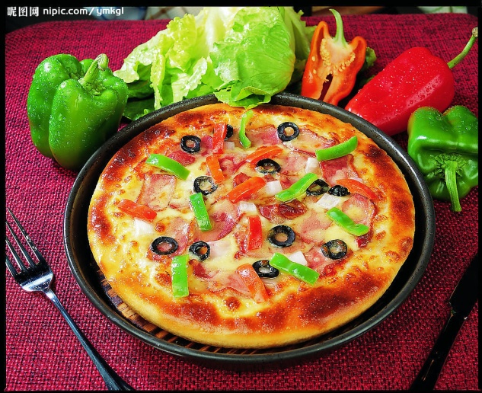
怎么样？ zěnmeyàng How about?
Ask for opinion
你请我吃饭，怎么样？
How about...
you treat me to a meal?
Notes:
These 5 examples can show students the pattern. You can ask students to summarize how to use 怎么样 (after a statement, or right after a noun phrase).

Slide 20
怎么样？ zěnmeyàng How about?
Ask for opinion
我们七点吃饭，怎么样？
How about...
we eat at 7:00 pm?
Notes:
These 5 examples can show students the pattern. You can ask students to summarize how to use 怎么样 (after a statement, or right after a noun phrase).

Slide 21
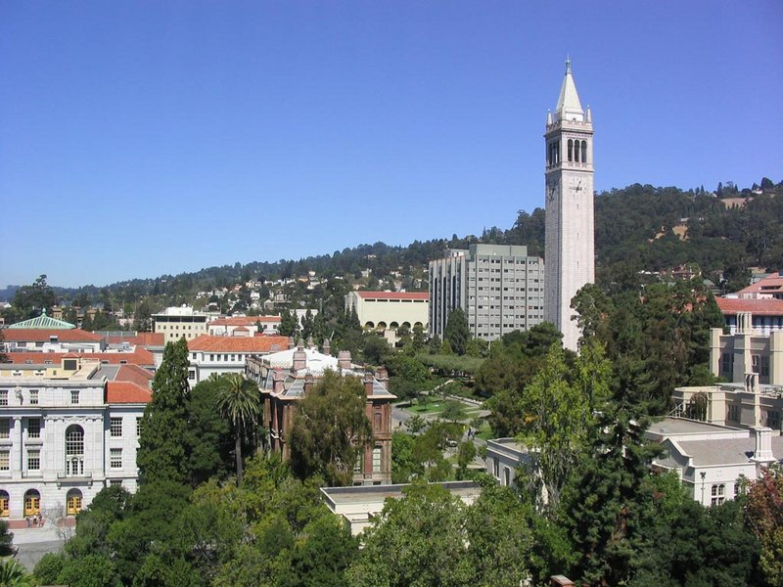
怎么样？ zěnmeyàng How about?
Ask for opinion
Q: 这个大学怎么样？
How about this university?
What do you think of this university?
A: 这个大学很好。
A: 这个大学不错。
Notes:
These 5 examples can show students the pattern. You can ask students to summarize how to use 怎么样 (after a statement, or right after a noun phrase).

Slide 22
怎么 zěnme (how to …) / 怎么样 zěnmeyàng (how about)
How to do something:
Wǒ bù zhīdào zěnme fùxí zhōngwén
Q: 我不知道怎么复习中文…
(I don’t know how to review Chinese.)
Xiǎo zhāng, nǐ zěnme fùxí
小张， 你怎么复习？
(Xiǎo Zhāng, how do you review?)

Slide 23
怎么 zěnme (how to …) Interrogative Pronoun
How to do something:
Nǐ jiào wǒ zěnme xiě nǐ de zhōngwén míngzì hǎo ma?
Q:你教我怎么写你的中文名字, 好吗？
You teach me how to write your Chinese name, OK?
Māmā, nín jiào wǒ zěnme zuò fàn, hǎo ma?
Q:妈妈，您教我怎么做饭，好吗？
Mom, (please) you teach me how to cook, OK?
____, 你教我怎么打球，好吗？

Slide 24
怎么 zěnme (How come…)
你怎么知道我的名字!
How come you know my name!
怎么小李没来上课?
Little Li didn’t come to the class, how come?
Nǐ píngcháng láidé hěn zǎo jīntiān zěnme láidé zhème wǎn
你平常来得很早，今天怎么来得这么晚？
You usually come early, how come you came so late today?

Slide 25
怎么+这么/那么＋adj How come____ so _____.
Time to gripe:
Dì qī kè de kèwén zěnme zhème nán
第七课的课文怎么这么难！How come …so difficult!
shēngcí zěnme nàme duō
生词怎么那么多！How come …so many!
yǔfǎ
语法 难！
gōngkè
功课 多！How come …so much!

