Slide 1

Dì kè: xué xiào shēng huó
第八课：学校生活Lesson Eight: School Life

Slide 2
Yī piān rì jì: Yī gè diǎn xíng de shàngxué rì
一篇日记：一个典型的学校日
A Diary: A Typical School Day

Slide 3
Yī fēng xìn: Tán xué zhōngwén
一封信：谈学中文
A Letter: Talking About Studying Chinese

Slide 4
Dì kè: xué xiào shēng huó
第八课：学校生活Lesson Eight: School Life
LEARNING OBJECTIVES:
In this lesson, you will learn to use Chinese to
Describe the routine of a student’s life on campus;
Write a simple diary entry;
Write a brief letter in the proper format;
Express your modesty in terms of your foreign language ability;
Invite friends to go on an outing.

Slide 5
Dì kè: xué xiào shēng huó
第八课：学校生活 Lesson Eight: School Life
Forms & Accuracy:
1. The Position of Time-When Expressions
2. The Adverb 就 (jiù) (II)
3. 一边…一边… (yìbiān...yìbiān...)
4. Series of Verbs/Verb Phrases
5. The Particle 了 (le) (II)
6. The Particle 的 (de) (III)
7. The Adverb 正在 (zhèngzài)
8. 除了…以外, 还…(chúle...yǐwài, hái…)
9. 能 (néng) and 会 (huì) (I) Compared
10. The Adverb 就 (jiù) (III)

Slide 6
第八课 对话一
Shēng cí
生词
vocabulary

Slide 7
学习中文 xuéxí zhōngwén (study Chinese)
        学习 study
        预习 preview
        练习 practice
        复习 review
        准备 prepare
        念 read
        写 write
        教 teach
        懂 understand
        难 difficult
        课文 text
        生词 new word(s)
        语法 grammar
        录音 recording
        功课 homework
        作业
        笔、纸 pen、paper

Slide 8
新
xīn
New
adj

Slide 9
累
lèi
Tired
adj

Slide 10

教室
jiàoshì
classroom
n

Slide 11
那儿
nàr
there
pr

Slide 12

发音
fāyīn
Pronunciation
n

Slide 13
日记
rìjì
Diary
n

Slide 14

篇
piān
measure word for essays, articles, etc.
m

Slide 15

电脑
diànnǎo
computer
n

Slide 16

脑
nǎo
Brain
n

Slide 17
早饭
zǎofàn
Breakfast
n

Slide 18
午饭
wǔfàn
lunch, midday meal
n

Slide 19

中午
zhōngwǔ
Noon
n

Slide 20
餐厅
cāntīng
dining room, cafeteria
n

Slide 21

起床
qǐ chuáng
to get up
vo

Slide 22
床
Chuáng
Bed
n

Slide 23

洗澡
xǐ zǎo
to take a bath/shower
vo

Slide 24


上网
shàng wǎng
to go online; to surf the internet
vo

Slide 25

告诉
gàosu
to tell
v

Slide 26

知道
zhīdao
to know
v

Slide 27
已经
yǐjīng
Already
adv

Slide 28
一边
yìbiān
simultaneously; at the same time
adv

Slide 29
正在
zhèngzài
in the middle of (doing something)
adv

Slide 30
以前
Yǐqián
Before
t

Slide 31
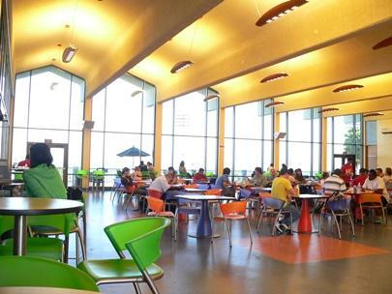
日记 rìjì (diary) noun
Q:你写日记吗？
A:我不写日记。

Slide 32

篇 piān The measure word for diary, article etc.
piān rì jì
一篇日记
a diary entry

Slide 33




新 xīn (new) adjective
xīn nián
新年
xīn péng yǒu
新朋友
xīn diàn nǎo
新电脑
xīn shēng ér
新生儿
New Year
New Friend(s)
New computer(s)
New born baby(s)

Slide 34
新 xīn (new) adjective
Zhè shì xīn de diànnǎo
这是新的电脑。
This is a new computer.
Dì bā kè shì xīn de kè
第八课是新的课。
Lesson 8 is a new lesson.

Slide 35
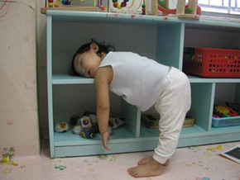
累 lèi (tired) adjective
她累了！
她很累！
我今天很累。
打球很累。
玩手机很累。

Slide 36

累 lèi (tired) adjective
Nǐ juédé lèi ma
Q：你觉得累吗？Are you tired?
A1:我很累。I am very tired.
A2:我有一点儿累。I am a bit tired.
A3:我不累。I am not tired.
A4:我一点儿都不累。I am not tired at all.

Slide 37
发音 fāyīn (pronunciation) noun
Tā de zhōngwén fāyīn hěn hǎo
他的中文发音很好 。
His Chinese pronunciation is good.
Tā de rìwén fāyīn bù hǎo
他的日文发音不好 。
His Japanese pronunciation is not good.

Slide 38

电脑 diàonǎo (computer) noun
Q1: 你有电脑吗？ Do you have a computer?
A2: 我有电脑。
Nǐ yǒu diànnǎo kè ma
Q2: 你有电脑课吗？Do you have computer class?
A2: 我有电脑课。／我没有电脑课。
Nǐ de diànnǎo kè shì dì jǐ jié kè
Q3: 你的电脑课是第几节课？
What period is your computer class?
A3: 我的电脑课是第四节课。

Slide 39

教室 jiàoshì (classroom) noun
Zhōngwén jiàoshì zài nǎlǐ
Q：中文教室在哪里？
Where is the Chinese classroom?
Zhōngwén jiàoshì shì jǐ hào
Q：中文教室是几号？
What number is the Chinese Classroom?
A：中文教室在2205。

Slide 40
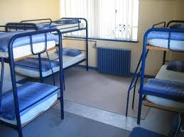
宿舍 sùshè (dormitory) noun
Nǐ zhù zài jiā hái shì sùshè
Q:你住在家还是宿舍？
Do you live at home or in a dormitory.
A:我住在家里。
Q:IHS 有没有宿舍？
A:IHS 没有宿舍。
Q:你想住宿舍吗？
A:我（不）想住宿舍。

Slide 41
餐厅 cān tīng (restaurant, cafeteria) noun
Nǐ xǐhuān xuéxiào de cāntīng ma
Q: 你喜欢学校的餐厅吗？
Do you (don’t) like the school’s cafeteria?
A: 我（不）喜欢学校的餐厅。
Nǐ xǐhuān nǎ jiā cāntīng ma
Q: 你喜欢哪家餐厅？ Which restaurant do you like?
A: 我喜欢 _________。
餐厅 = 餐馆 = 饭厅 = 饭馆

Slide 42
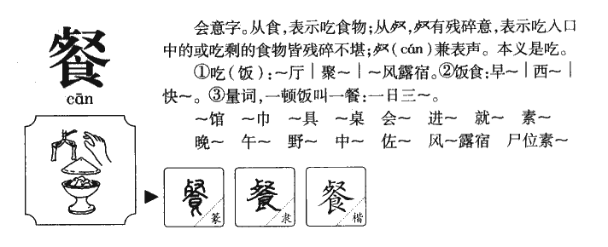
食 部首 Radical
Notes:
餐 https://www.youtube.com/watch?v=gC3pLBk5fNE

Slide 43
食 部首 Radical
fàn
饭
jiǎo
饺
yǐn
饮
è
饿
guǎn
馆
Notes:
餐 https://www.youtube.com/watch?v=gC3pLBk5fNE

Slide 44

三餐 cān (The three meals)
早餐/饭 breakfast
午餐/饭 lunch
晚餐/饭 dinner
餐vs饭
Q: 你平常几点吃 _____? (早饭/午饭/晚饭）
A: 我平常七点吃 _____。

Slide 45

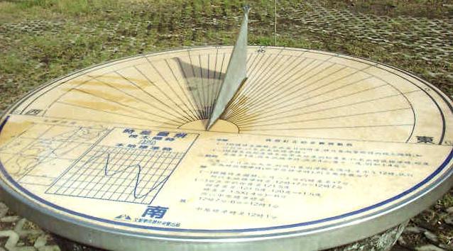
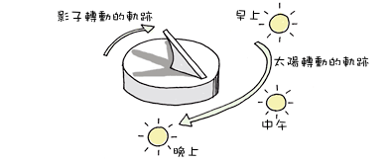
午 wǔ (noon)
上午 中午 下午
日晷 sundial

Slide 46
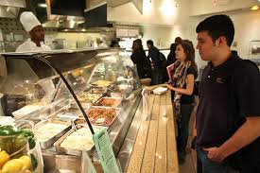
中午 zhōngwǔ (noon) noun
Nǐ zhōngwǔ zài nǎ‘er chīfàn
Q:你中午在哪儿吃饭？
Where do you have lunch (at noon)?
Wǒ zài xuéxiào cāntīng chīfàn
A:我在学校餐厅吃饭。（吃中饭）
I have lunch at the School’s cafeteria.

Slide 47
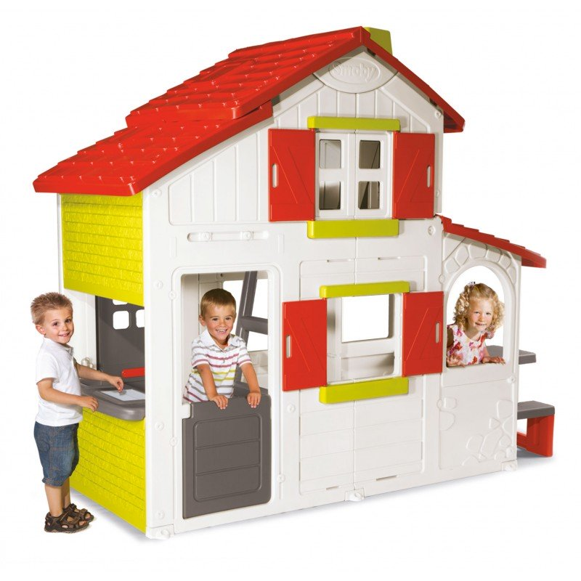
这儿 zhèr (here) pronoun
Nǐ zài nǎ'er
Q:你在哪儿？
Where are you?
A:我在我朋友这儿。
I am here at my friend’s place.

Slide 48
那儿 nàr (there) pronoun
Wǒ de shū zài nǎ er
Q:我的书在哪儿？ Where is my book?
Nǐ de shū zài nà er
A:你的书在那儿。 Your book is there.

Slide 49
那儿 nàr there
你到那儿的时候,请打电话给我。
Nǐ dào nà'er de shíhòu, qǐng dǎ diànhuà gěi wǒ
Please give me a call when you arrive there.
那儿 nàr (there) v.s. 哪儿 nǎr (where)
Q:我的书在哪儿？
A:你的书在那儿。

Slide 50
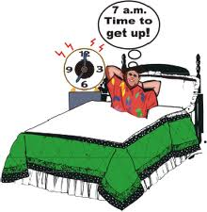
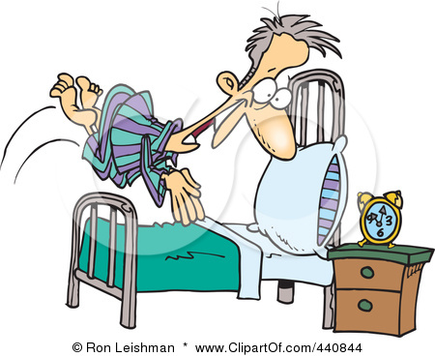
起床 qǐ chuáng (to get up) verb+object
Nǐ zǎoshang jǐ diǎn qǐchuáng
Q1:你早上几点起床?
When do you get up in the morning?
A1:我早上七点起床。
Nǐ píngcháng wǎnshàng jǐ diǎn shàngchuáng shuìjiào
Q2:你平常晚上几点上床睡觉？
When do you usually go to bed at night?
A2:我平常__________上床睡觉。

Slide 51

洗澡 xǐzhǎo (to take a bath/shower) Verb+Object
Nǐ xǐhuān zǎoshang xǐzǎo háishì wǎnshàng xǐzǎo
Q1:你喜欢早上洗澡还是晚上洗澡？
Do you like to take a shower in the morning or at night?
A1:我喜欢晚上洗澡。
Nǐ xǐzǎo xǐ dé hěn kuài háishì hěn màn
Q2:你洗澡洗得很快还是很慢？
Do you shower quickly or shower slowly?
A2:我洗澡洗得很慢。

Slide 52
知道 zhīdào （to know） Verb
你知道吗？Do you know…?
Nǐ zhīdào tā jiào shénme míngzì ma
Q:你知道他叫什么名字吗？
Do you know what his name is?
A:我知道/不知道。
Nǐ zhīdào jīntiān yǒu zhòng wén kǎoshì ma
Q:你知道今天有中文考試吗?

Slide 53
知道 zhīdào （to know） Verb
Nǐ zhīdào zěnme qù wǒ de jiā ma
Q:你知道怎么去我的家吗？
Do you know how to go to my house?
A:我知道/不知道。
Nǐ zhīdào zěnme
Q:你知道怎么_____________?
Do you know how to

Slide 54
告诉 gàosù (to tell) verb
他告诉我…
míngtiān yǒu yīgè kǎoshì
…明天有一个考试。 There is a test tomorrow.
Tā jīntiān wǎnshàng yào qù kàn diànyǐng
…她今天晚上要去看电影。
…他喜欢她。
zhè shì bùyào gàosù biérén
…这事不要告诉别人。Don’t tell others about this matter.

Slide 55
第八课 对话一
Yǔ fǎ
语法
grammar

Slide 56

正在 Zhèngzài (in the middle of doing something) adverb
Xiǎo wáng zhèngzài zuò shénme
Q: 小王正在做什么?
What is Little Wang doing?
Tā zhèngzài zuò gōngkè
A: 他正在做功课。
He is doing homework.

Slide 57
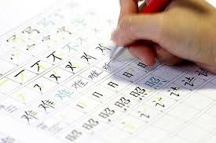
正在 Zhèngzài (in the middle of doing something) adverb
Tā xiànzài zhèngzài zuò shénme
Q: 她现在正在做什么？
What is she doing now?
Tā xiànzài zhèngzài xiě hànzì
A: 她现在正在写汉字。
She is writing Chinese Characters now.

Slide 58
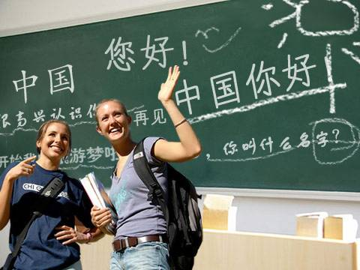
正在 Zhèngzài (in the middle of doing something) adverb
Tāmen xiànzài zhèngzài zuò shénme
Q: 他们现在正在做什么？
What are they doing right now?
Tāmen xiànzài zhèngzài shàng zhōngwén kè
A：他们现在正在上中文课。
They are taking a Chinese lesson.

Slide 59
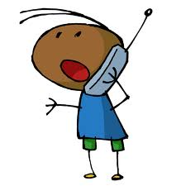
…的時候,正在… (when A …, B is doing…)
Wǒ dǎ diànhuà gěi nǐ de shíhòu
Q:我打电话给你的时候，
Nǐ zhèngzài zuò shénme
你正在做什么？
What are you doing when I call you?
洗澡 xǐzhǎo
A: 我正在__________。
I am taking a shower.

Slide 60

…的時候,正在… (when A …, B is doing…)
Wǒ dǎ diànhuà gěi nǐ de shíhòu
Q:我打电话给你的时候，
Nǐ zhèngzài zuò shénme
你正在做什么？
What are you doing when I call you?
A:我正在学习中文。
I am studying Chinese.

Slide 61

一边…一边 yì biān… yì biān… (simultaneously, at the same time )
Zhège nǚhái zài zuò shénme
Q:这个女孩在做什么？
What is the girl doing?
Tā zài yībiān tīng yīnyuè yībiān zuò gōngkè
A:她在一边听音乐，一边做功课。
She is listening to music while doing homework.

Slide 62
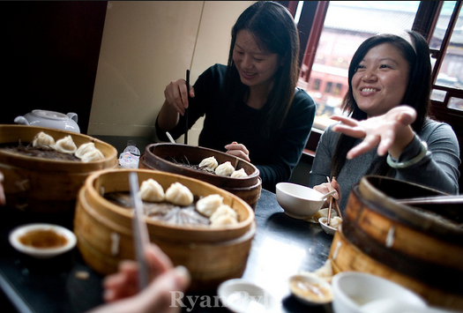
一边…一边 yì biān… yì biān… (simultaneously, at the same time )
Tāmen zài zuò shénme
Q:她们在做什么？
What are they doing?
Tāmen zài yībiān yībiān
A:她们在一边______，一边________。
吃饭 聊天儿
They are chatting while eating.

Slide 63

一边…一边 yì biān… yì biān… (simultaneously, at the same time )
Tā zài zuò shénme
Q:他在做什么？
What is he doing?
Tā zài yībiān yībiān
A:他在一边________，一边__________。
上网 听音乐
He is listening to music while surfing the internet.

Slide 64
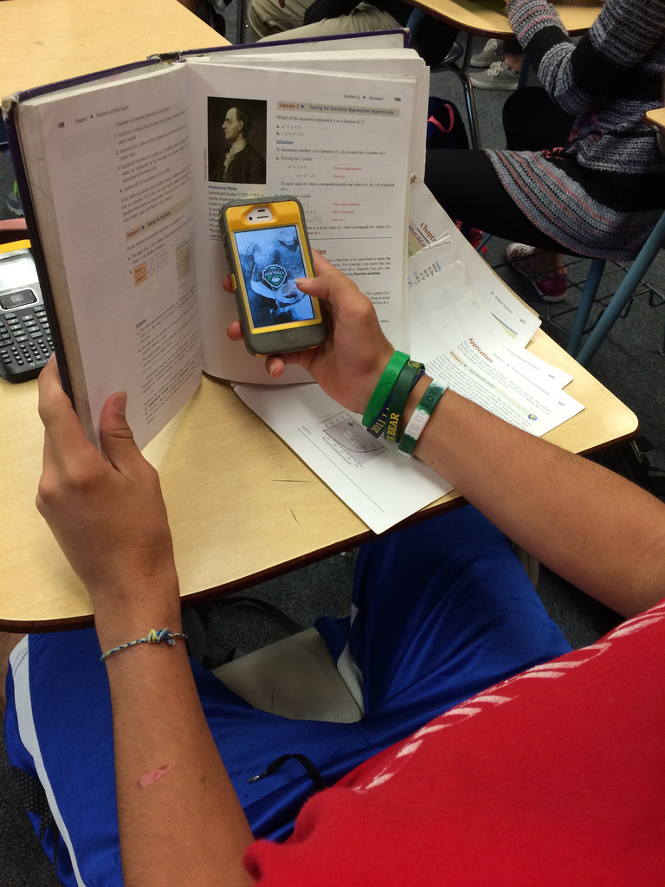
一边…一边 yì biān… yì biān… (simultaneously, at the same time )
Tā zài zuò shénme
Q:他在做什么？
What is he doing?
Tā zài yībiān yībiān
A:他在一边________，一边__________。
上课 玩手机
He is playing on his cellphone while is in class.

Slide 65
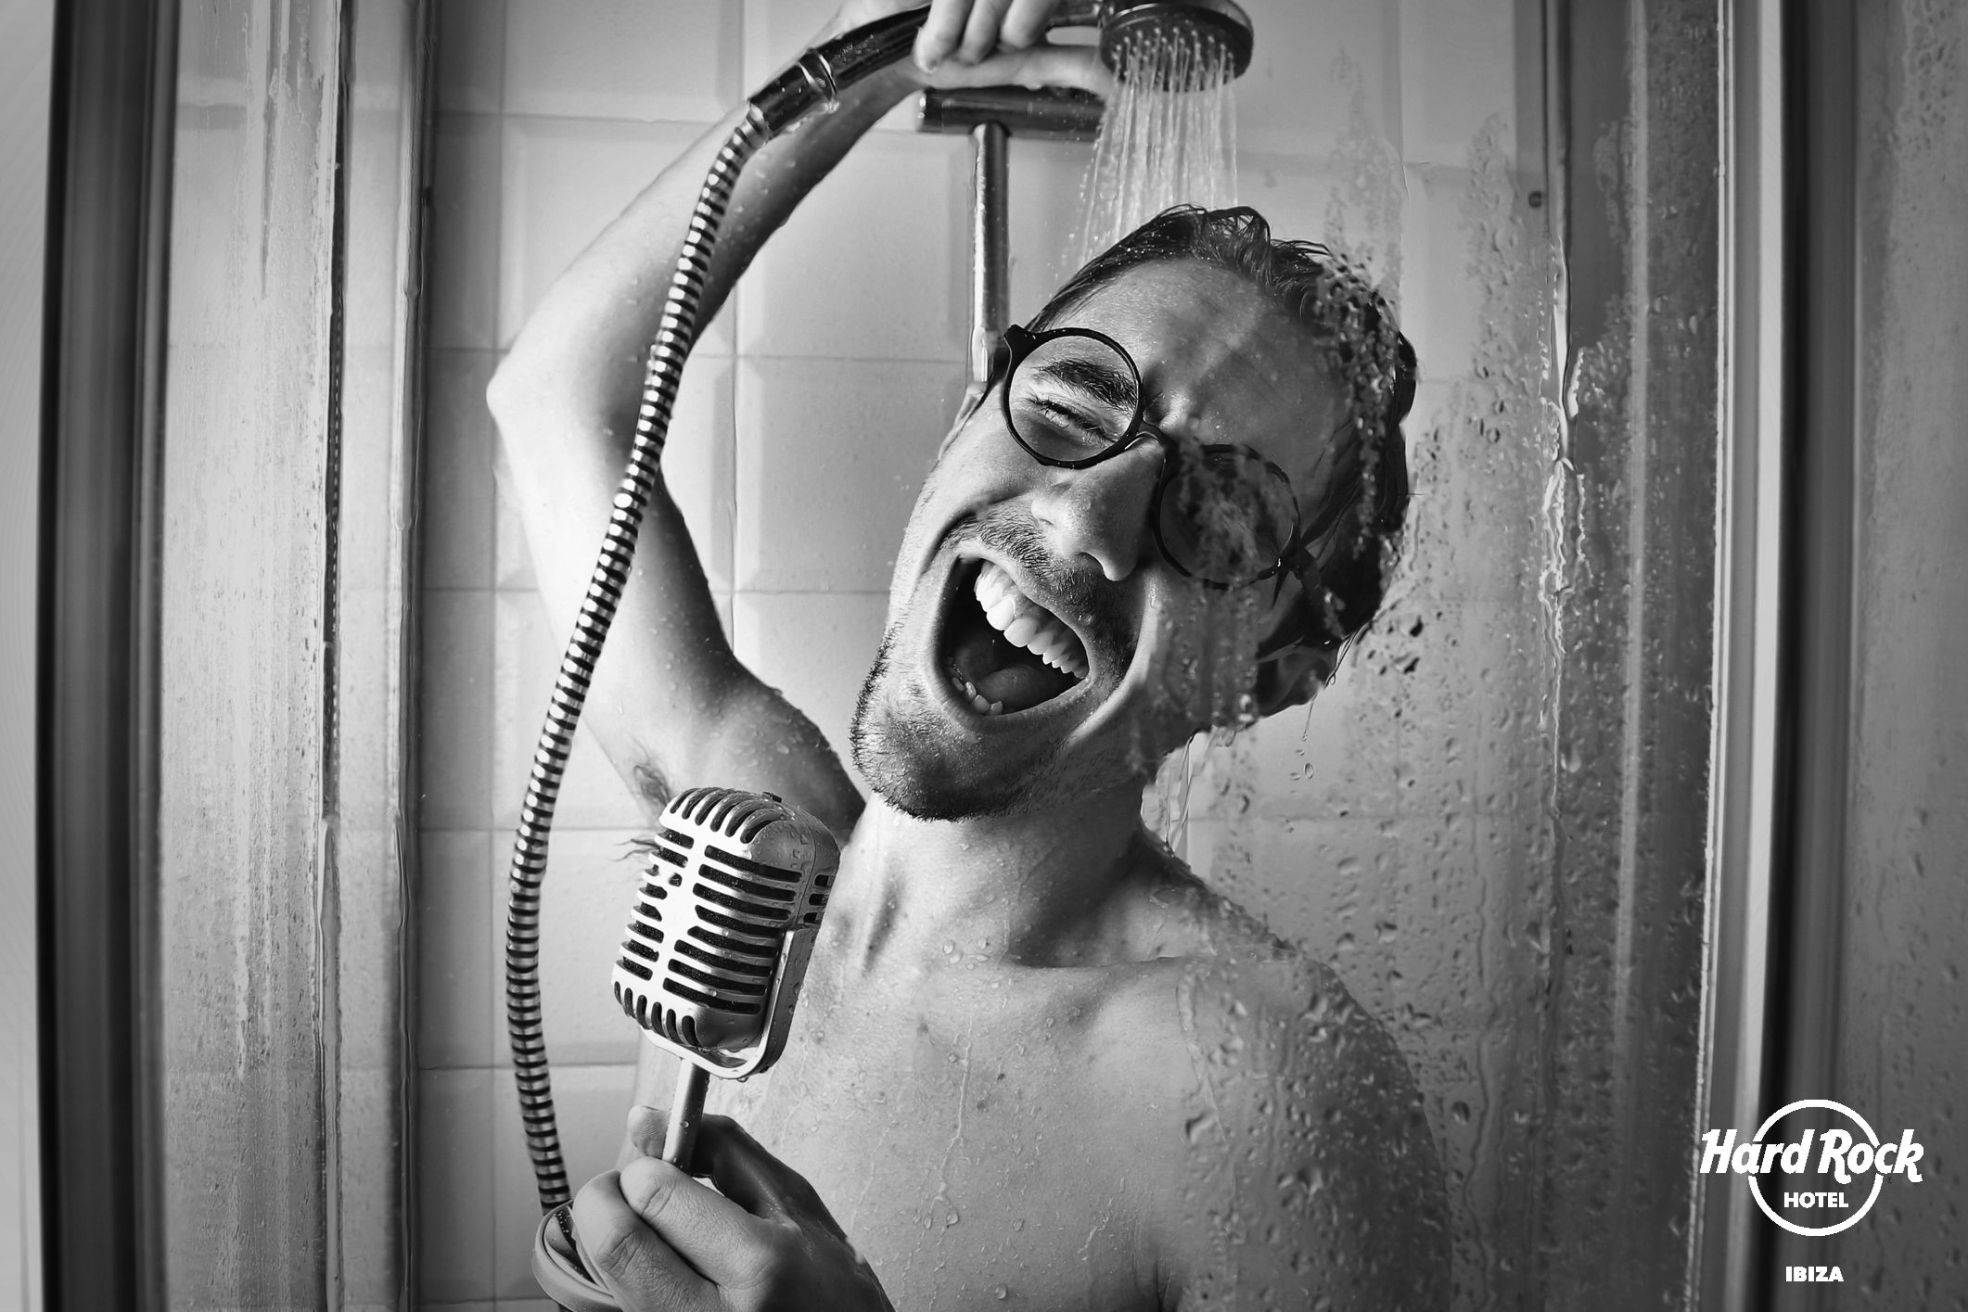
一边…一边 yì biān… yì biān… (simultaneously, at the same time )
Tā zài zuò shénme
Q:他在做什么？
What is he doing?
Tā zài yībiān yībiān
A:他在一边________，一边__________。
洗澡xǐzhǎo 唱歌
He is singing while taking a shower.

Slide 66


已经 yǐjīng (already) adverb
Q：你吃了吗？ Did you eat?
你吃早餐了吗？Did you eat breakfast?
A: 我已经吃了。 I already ate.
Q: 你看了吗？ Did you see?
你看了那个电影了吗？Did you see the movie?
A: 我已经看了。 I already saw it.

Slide 67
已经 yǐjīng (already) adverb
Nǐ yùxí dì bā kèle ma
Q: 你预习第八课了吗？
Did you preview Lesson 8?
Wǒ yǐjīng yùxí dì bā kèle
A: 我已经预习第八课了。
I already previewed Lesson 8.
第八课：
xiě yī piān rìjì
写一篇日记
Write a Diary

Slide 68
以前 yǐqián (before) time expression
Yǐqián wǒ bù huì shuō Zhōngwén
以前我不会说中文 。
Before, I could not speak Chinese.
Yǐqián wǒ bù rènshi tā.
以前我不认识他。
I didn’t know him before.
以前 v.s. 以后

